Slide 1

Puberty
Year 7 Health – 2024
Lesson 4

Slide 2

Today’s focus
Define puberty .
Understand the purpose of puberty.
Identify social, emotional, and physical changes that occur to males and females.

Slide 3

(pg.35)
In the first 5 minutes of each lesson, you will complete your revision page, you will find these throughout your booklet.
The revision page consists of three questions. It will need to be completed in detail. One-word answers will not be accepted.
The three questions :
What two concepts or ideas did I learn in class last week?
What did I find interesting about last week’s lesson? Provide a specific example.
Any questions or new words you have learnt?
The teacher will go over this each lesson with you to see what you have learnt. It is a great way for you to revisit content and test your memory.

Slide 4

Expectations
Puberty is a time that every single person will go through at some stage.
EVERYONE is different and has their own experiences with puberty.
We need to be respectful of everyone’s thoughts/feelings/experiences of this time.
Approach the topic with a level of maturity.
Get used to saying the proper terminology.

Slide 5

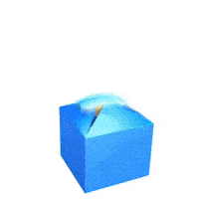
Question Box
If you have a question that you want to ask but you don’t want to ask it out loud… write it on a piece of paper and place it in the question box.
In some lessons we will read out questions that are in the box and your teacher will answer them.
You do not need to write your name – you can remain anonymous if you like!
If you would like to have a chat with your teacher, write your name on your question paper and they can speak with you personally, or just ask to have a chat!

Slide 6
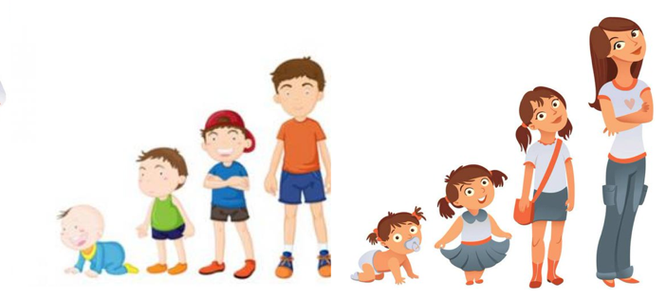
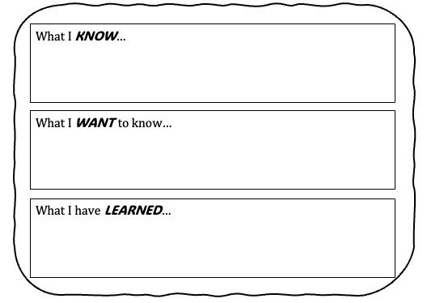
Activity 1: Puberty KWL (pg.36)
Complete the first two boxes of the KWL:
What do you already know about puberty?
What do you want to know about puberty?
Leave the last box empty because we will revisit this at the end of the term to complete it.
You have 4 minutes.

Slide 7
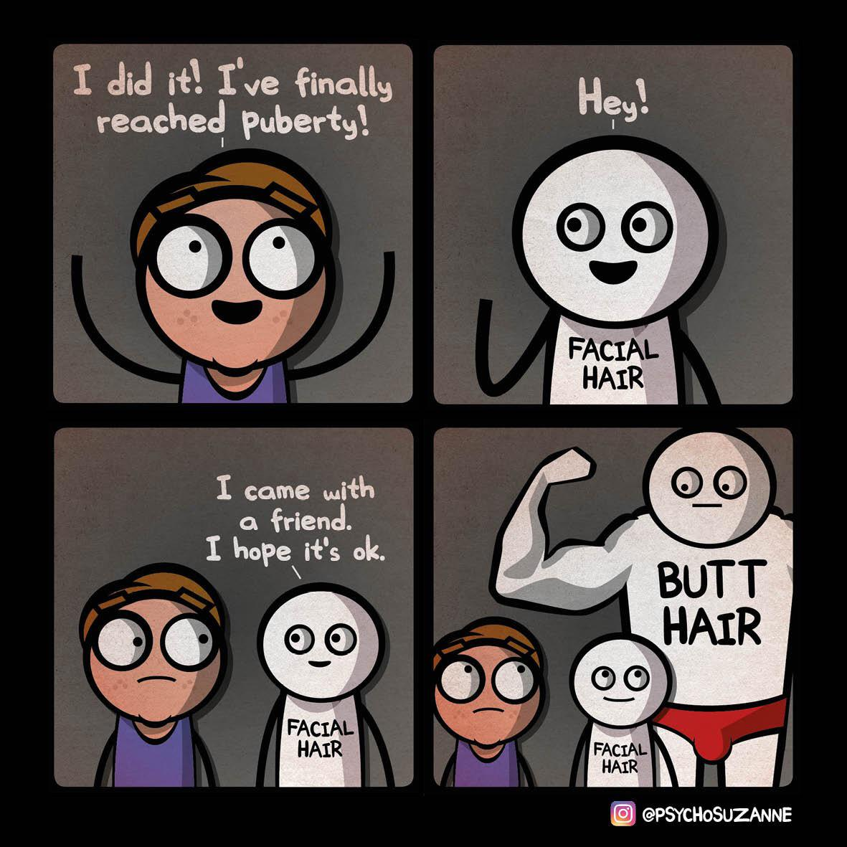
Hook #1: What words do you know?
All students stand around the room in a circle.
The only person who is allowed to talk is the person with the ball.
Once you have answered the question, you throw the ball to someone new.
Q: What words come to mind when you hear PUBERTY?
You cannot:
Call out without the ball.
Use any swear words or say more than one word at a time.
Shout out loud.
Ideas: changes that happen to the body, reasons for puberty, feelings that you may feel during puberty, activities you start to do as you get older, words related to relationships etc.
Notes:
Two options for a hook activity – this is option 1.
Choose what option you would prefer and what would best suit your class.
Resources – stress ball (something to throw and catch around the room)
The idea behind this game is to break the ice around the topic of puberty. This is an opportunity for students to use slang terminology and funny words before they are expected to use proper terms moving forward. If students are struggling to think of a word or they feel uncomfortable, encourage them to think of other words associated with the ‘ideas’ at the bottom of the slide.
After this activity, emphasise that students are expected to use correct terminology moving forward (i.e., penis instead of willy etc.).
For example:
- period (a change that occurs during puberty)
- willy (a slang term for penis)
- confused (an emotion that may be felt during puberty)
- boyfriend/girlfriend (a relationship that may start to develop during pubescent years)
- hormones (the thing that triggers puberty in our body)
- movies (something we do with our friends as we get older)

Slide 8

Hook #2: Brain Dump (pg.37)
Write down at least 10 ideas that come to mind relating to things you already know about Puberty.
You have 3 minutes.
Notes:
Two options for a hook activity – this is option 2, part 1.
Choose what option you would prefer and what would best suit your class.
Students can write their answers in their workbook.

Slide 9
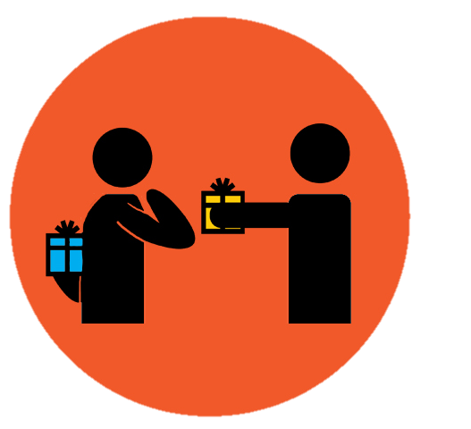
Hook #2: Give one, get one (pg.37)
Now you have your brainstorm of 10 ideas move around the classroom and talk to others. Give them one of your answers and get one of theirs in return.
Sit down again when you have added 10 new puberty ideas to your list (or have 20 in total).
You have 3 minutes.
Notes:
Two options for a hook activity – this is option 2, part 2 → This is OPTIONAL.
Choose what option you would prefer and what would best suit your class.
Students can write their answers in their workbook.

Slide 10
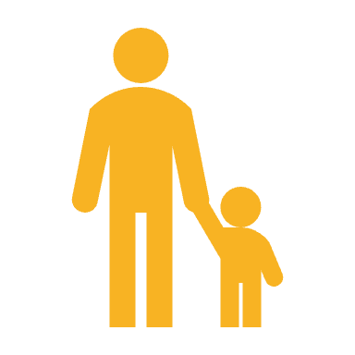
Why do we need to learn about this stuff? (pg.37)
When we talk about the changes that occur during puberty, we will talk about them in relation to people born with a male reproductive system (male) and people born with a female reproductive system (female).
It is important for us to learn about puberty because these are changes and experiences that are going to directly affect you and impact your life. It is also going to happen to every single person – your parents and grandparents experienced it, your friends will go through it, and eventually all the babies in the world will go through it too (even pet dogs!).
It is important to learn about it so you can prepare for the changes that are going to occur and you can understand why they are happening. It is also beneficial for females to learn about the male changes, and males to learn about the female changes, because you will have these people in your life – whether they be friends, family, coworkers, teammates or even lovers. If you know and understand what is happening, then you can help each other through the rollercoaster ride that is puberty.
Notes:
Also in their books.

Slide 11

GLOSSARY: (Pg. 5)
At the front of your books is your glossary. Turn to your glossary and add the following words and their definitions:
Puberty
The period during which adolescents reach sexual maturity and become capable of reproduction.
Adolescence
The period where a young person develops from a child into an adult.
Reproduction
The production of offspring (children) which occurs through sexual intercourse.
Notes:
Relevant to test

Slide 12
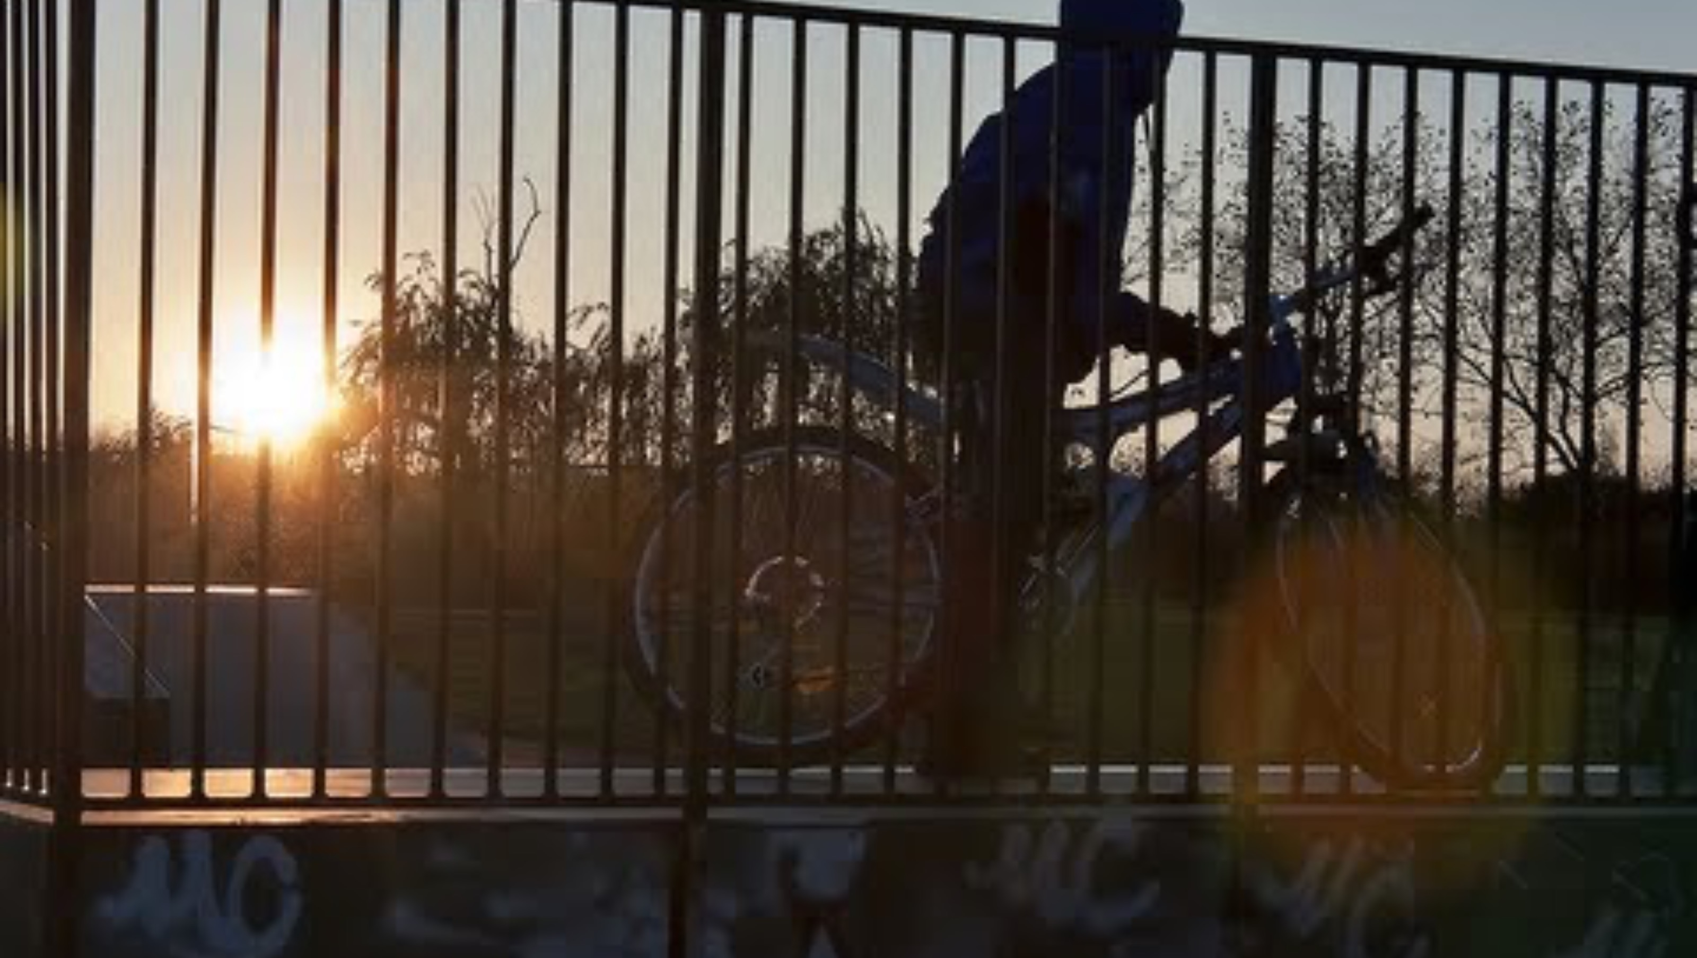
Puberty: (pg.38)
The changes that occur during puberty can be categorised as:
PHYSICAL
SOCIAL
EMOTIONAL
The purpose of puberty is to allow the body to mature into an adult and become capable of sexual reproduction.
The trigger for puberty is the production of ‘gonadotrophin releasing hormone’ (GnRH) from a part of the brain called the hypothalamus.
This hormone (GnRH) stimulates the pituitary gland to send a signal to the ovaries in a girl, and the testes in a boy, to release their sex hormones.
Notes:
RELEVANT TO TEST (purpose of puberty)
Video is optional but accompanies the extra information on the slide.
1.38mins - https://www.youtube.com/watch?v=Y-m4ppqMLPc

Slide 13
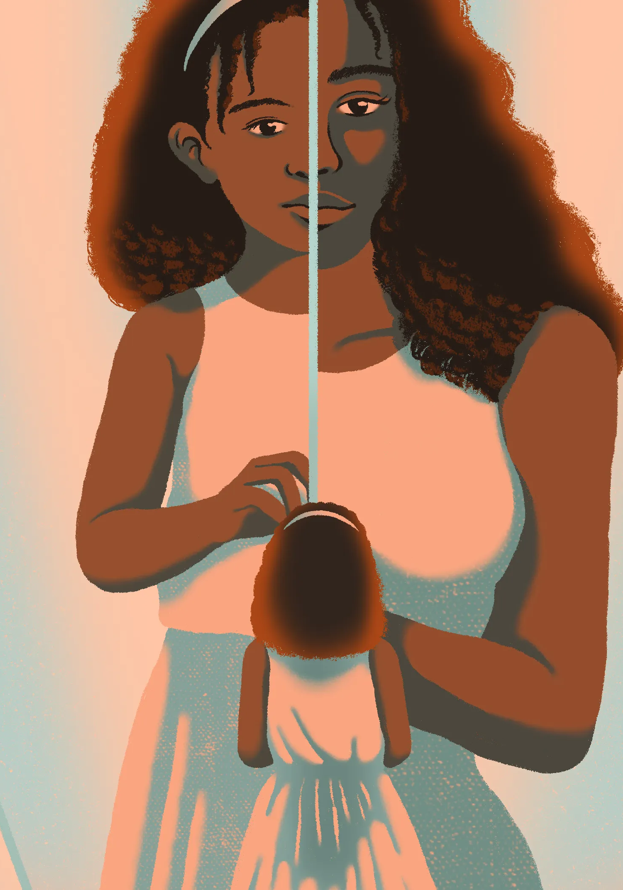
Activity 1: (pg.38)
In the space provided in your books answer the questions below:
What is puberty?
What is the purpose of puberty?
What causes puberty to happen?
How do you feel about puberty?
Make sure you write your answers in your own words.
Once finished, discuss your answers with your partner.
Be prepared to share your answers with the class.
You have 6 minutes.
Notes:
RELEVANT TO TEST

Slide 14
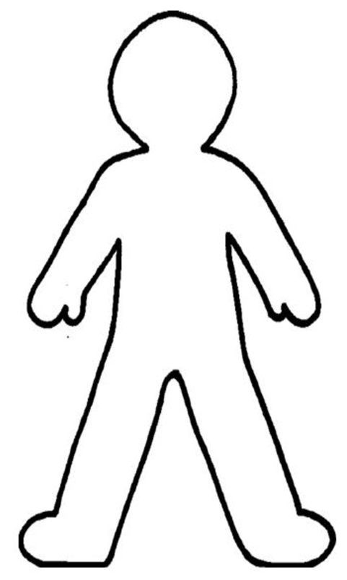
Activity 2: Puberty Changes (pg.39)
Mood swings
Breasts develop
Watch the videos over the next slides about puberty changes in boys and girls.
Choose 3 different colours - one for boys, one for girls and one for both.
While watching ‘Puberty for Boys,’ label the changes that occur and draw a line to show where on the body that change occurs.
Repeat for ‘Puberty for Girls.’
Using your third colour, highlight/underline/draw a circle around the changes that occur to BOTH males and females during puberty.
Erections become possible
Notes:
RELEVANT TO TEST
ALTERNATIVE:
- all students can complete this as a hard copy.
- students can complete this in groups or individually on A4, A3 or butcher’s paper and they can draw their own person.
- If students are unable to draw lines or change font colours, they can simply list the changes in the respective boxes on their page.
- if students are completing this as a hard copy or can draw lines and change font colours, then they can complete the activity as outlined in their books and on the slide.
Example provided:
- Purple = girls changes
- Red = boys changes
- Yellow = occurs to both

Slide 15

Notes:
5mins
Allow 2 mins after the video to add to their work.

Slide 16

Notes:
4.29mins
Allow 2 mins after the video to add to their work.

Slide 17
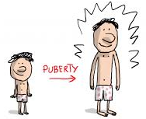
Activity 3: Physical, Social and Emotional Changes (pg.40)
Now you have learnt about some of the physical changes that occur during puberty, but what about the social and emotional ones that may happen?
Social changes are those changes that may happen around our relationships with our friends, family, lovers etc. Emotional changes are those changes that involve our feelings – how we feel about ourselves and others.
Complete the table in your books by researching the answers – physical changes for girls and boys, social and emotional changes for both.
A minimum of 7x changes that occur during puberty in each column.
You can use the changes you wrote down from your previous activity, but you are still expected to find extras.
You may work in pairs.
Some websites are given to you in your books to help you.
You have 15 minutes.
Notes:
RELEVANT TO TEST
Some websites are listed in their books as links for them to click on. They are also listed below:
Better Health Channel - Puberty
Kids Health.org - Puberty Basics
Health Direct - Puberty for Girls
Health Direct - Puberty for Boys
Answers on next slide.

Slide 18
PHYSICAL CHANGES MALE | PHYSICAL CHANGES FEMALE | SOCIAL/EMOTIONAL CHANGES
Growth spurt Testicle growth Penis growth Facial and body hair Voice deepens Pubic hair Adam’s apple develops Increased muscle mass Acne Sweat glands develop Sperm production Shoulders broaden | Menstruation/period Breast development Growth spurt Hips widen Pubic hair Vaginal changes (growth and discharge) Acne Sweat glands develop | Mood swings Development of relationships with friends Desire to challenge authority/rebel Confidence/self-esteem may decrease Body image concerns Want more independence Become interested in romantic relationships Social comparison Develop identity Develop social skills Explore sexual orientation
Notes:
RELEVANT TO TEST
Answers to activity 3. These are also provided in the answer key for the topic test.

Slide 19

EXIT TICKET:
Share one thing you are excited about in your adolescent and teenage years.
Optional: Write a question for the question box.

Slide 20
Puberty
Year 7 Health – 2024
Lesson 5

Slide 21
Today’s focus
Identify skills, emotions and items necessary to survive puberty.
Define hormones, primary and secondary sex characteristics.
Identify the main male and female sex hormones.
Create a timeline summary of the changes that occur during puberty.

Slide 22
(pg. 41)
In the first 5 minutes of each lesson, you will complete your revision page, you will find these throughout your booklet.
The revision page consists of three questions. It will need to be completed in detail. One-word answers will not be accepted.
The three questions :
What two concepts or ideas did I learn in class last week?
What did I find interesting about last week’s lesson? Provide a specific example.
Any questions or new words you have learnt?
The teacher will go over this each lesson with you to see what you have learnt. It is a great way for you to revisit content and test your memory.

Slide 23
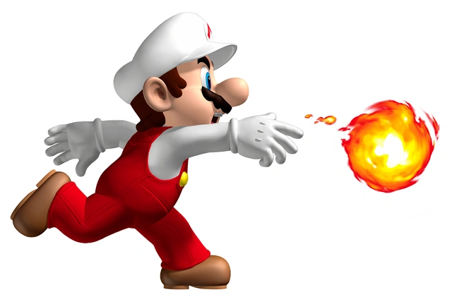

HOOK: Rapid Fire Puberty Changes (pg.42)
Working in pairs.
List as many changes that occur during puberty as possible.
Think about PHYSICAL, SOCIAL and EMOTIONAL changes.
The pair to get the most correct changes wins a prize.
You have 2 minutes.

Slide 24
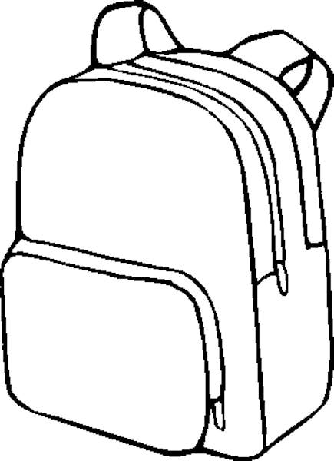
Activity 1: puberty backpack (pg.43)
How can you prepare for puberty?
Create a puberty backpack filled with items and skills you can use to survive the years of puberty.
Make this backpack specific to yourself – what will you need?
In the small pocket – skills and emotions you can use.
In the big pocket – physical items you can use.
You can write words OR draw pictures.
Think about all the changes that can occur during puberty and how you can address/manage/deal with them.
You have 15 minutes.
Notes:
Adjust time as necessary
SUGGESTION – complete this activity as a hard copy for everyone. That way they can take it home with them to remind them of their survival kit. It will also allow the students to get a little creative.
Resources – backpack w/s (one per student), coloured pencils/texters.
ALTERNATIVE – swap the order of this lesson and complete the timeline activity as activity 1, and the backpack as activity 2.
OPTIONAL – set homework for students to actually go and create their own survival kit at home with the physical items they identified as needing.

Slide 25
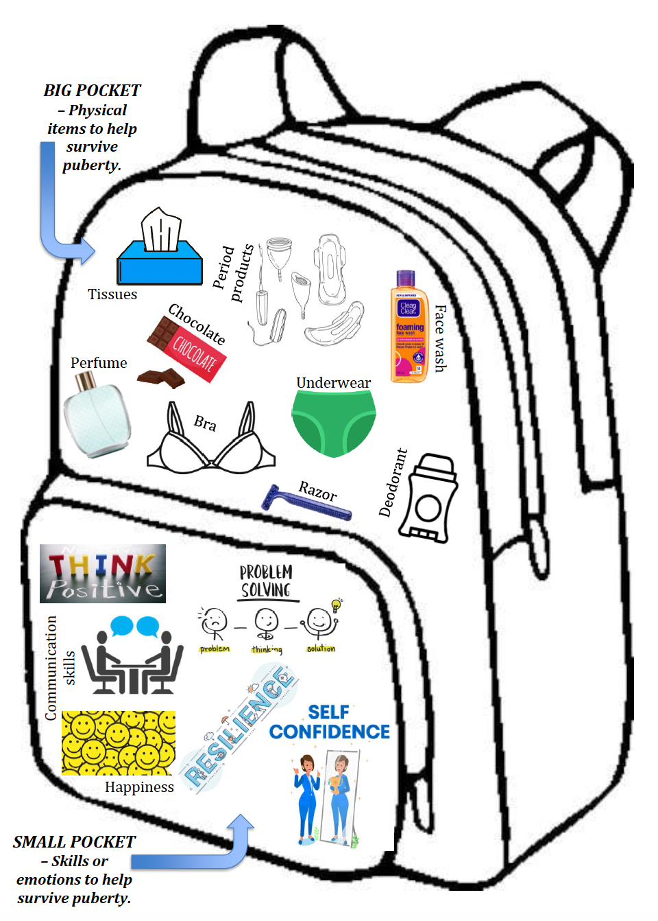
Notes:
Example of a puberty backpack. This example is not specific to either gender.
Some other examples can include:
Organisational skills
Kindness – to self and others

Slide 26
GLOSSARY: (Pg. 5)
At the front of your books is your glossary. Turn to your glossary and add the following words and their definitions:
Hormones
Chemical messengers that tell the body what to do.
After being made in one part of the body, they travel to other parts of the body where they help control how cells and organs do their work.
Primary Sex Characteristics
Changes that occur in the body to prepare for reproduction (e.g., ovulation in girls, sperm production in boys).
Secondary Sex Characteristics
Changes that occur in the body not related to reproduction but are a sign of sexual maturity (e.g., breast development in girls, voice deepening in boys).
Notes:
Relevant to test

Slide 27
How does it all happen? (pg.44)
The physical changes that occur at puberty are triggered by substances known as HORMONES.
They are chemical messengers that travel in the blood stream from the place where they are made (called glands) to the place where they do their work. Each hormone has a specific job.
The HYPOTHALAMUS (located in the brain) tells the body to release ’Gonadotropin Releasing Hormone’ (GnRH). This hormone stimulates the PITUITARY GLAND.
The PITUITARY GLAND, deep inside your brain, then sends out hormones to our sex organs to get them to start making SEX HORMONES.
For boys, it sends a signal to the TESTES.
For girls, it sends a signal to the OVARIES.
Notes:
Fill in the blanks
RELEVANT TO TEST

Slide 28
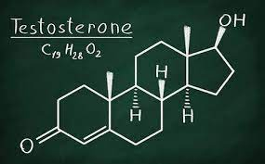
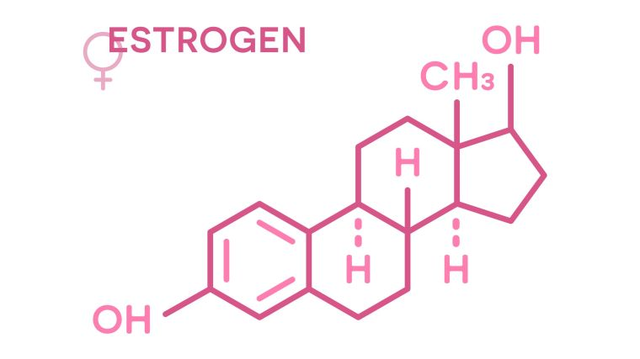
HOW DOES IT ALL HAPPEN? (pg.44)
Both boys and girls make the same sex hormones. The main ones are TESTOSTERONE and OESTROGEN.
Boys make lots of testosterone, not so much oestrogen. Therefore, the primary male sex hormone is TESTOSTERONE.
Girls make lots of oestrogen (primary sex hormone), not so much testosterone. Therefore, the primary female sex hormone is OESTROGEN.
Another hormone in girls that is essential during puberty is PROGESTERONE.
Testosterone and oestrogen help in the initiation of the primary and secondary sex characteristics in males and females.
Notes:
Fill in the blanks
RELEVANT TO TEST

Slide 29
Primary & Secondary Sex Characteristics (pg.45)
Until puberty, the growth and development of boys and girls is very similar. At puberty, under the influence of hormones, this development progresses along different paths.
The physical changes that occur during puberty can be broken down into Primary and Secondary Sex Characteristics.
PRIMARY Sex Characteristics are those changes that are DIRECTLY RELATED TO REPRODUCTION.
In boys, this includes the production of sperm in the testes.
In girls, this includes the onset of menstruation and ovulation.
The production of sperm and the onset of menstruation and ovulation are indicators that the person is now capable of reproducing.
SECONDARY Sex Characteristics are those changes that are not directly related to reproduction but are A SIGN OF SEXUAL MATURITY.
In boys, this includes the development of facial hair, the voice deepening (or ‘cracking’) and more muscle mass.
In girls, this includes the development of breasts and widening hips.
Notes:
Fill in the blanks
RELEVANT TO TEST

Slide 30
Activity 2: Puberty Timeline (pg.45-48)
Now we know about some of the changes that can happen and why they happen during puberty, but WHEN do these changes start to occur?
Your task:
Read through the information on the stages of puberty for males and females in your workbook.
Summarise and identify the changes that occur in each age bracket.
Write your answers in the space provided on the timeline in your workbook.
An example for each has been done for you in your books. You have 15 minutes and may work in pairs.
REVIEW question:
Do you notice anything when you compare the changes between males and females across your timeline? Any similarities or differences?
ANSWER: girls generally tend to start earlier than boys, and boys can continue their development longer and into their 20’s. Also, many of the changes are similar (i.e., pubic hair, growth spurts, hormonal changes etc.)
Notes:
Example and answers on the next slide.
ALTERNATIVE – swap the order of this lesson and complete the timeline activity as activity 1, and the backpack as activity 2.
OPTIONAL for students to work in pairs.

Slide 31
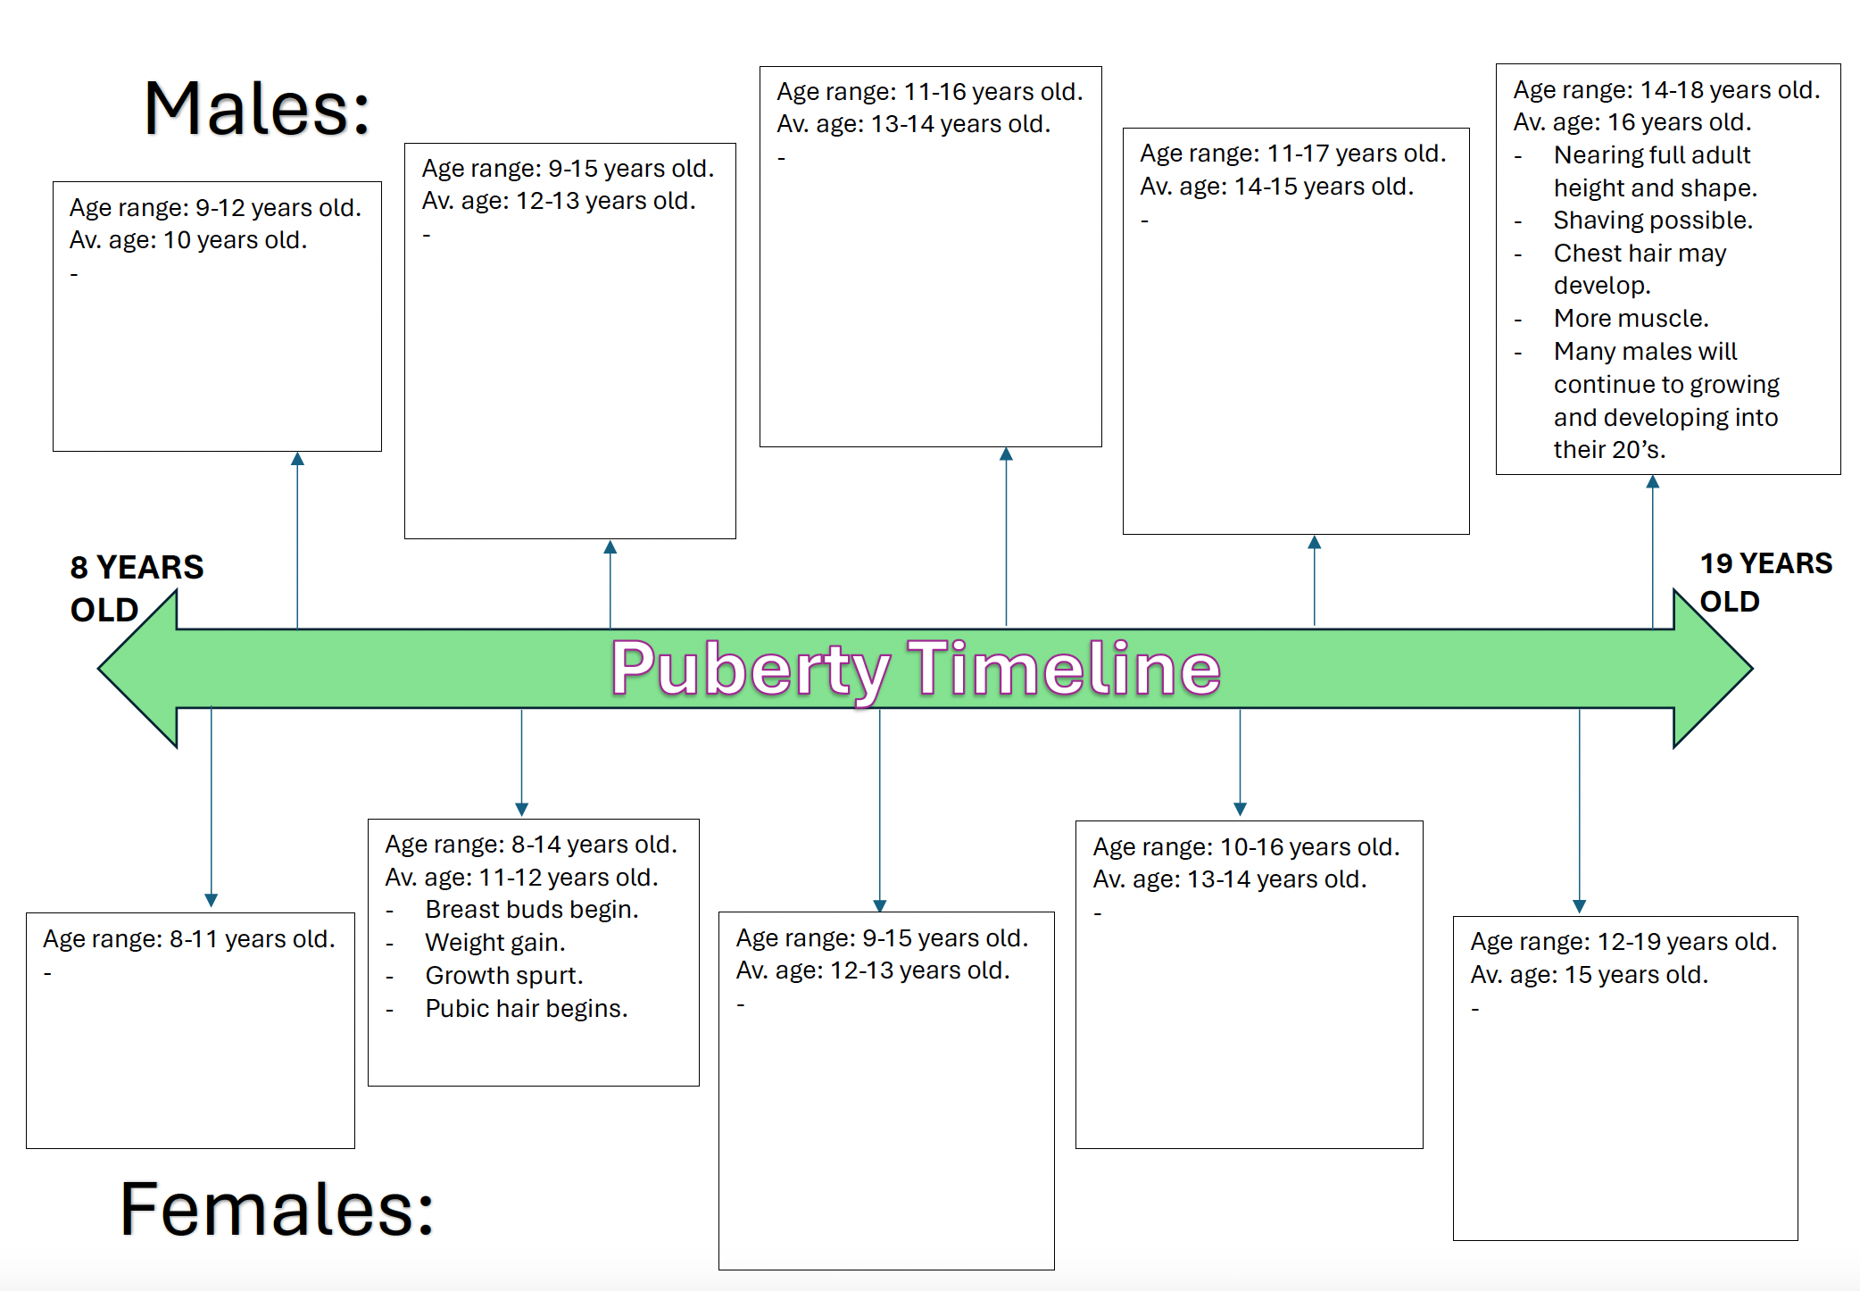
Notes:
Student version – in their workbooks. Use this to explain the examples.
Read the information from the teacher book.
- For males, the last paragraph has been summarised into the last box.
- For females, the second paragraph has been summarised into the second box).
Answers on the next slide

Slide 32
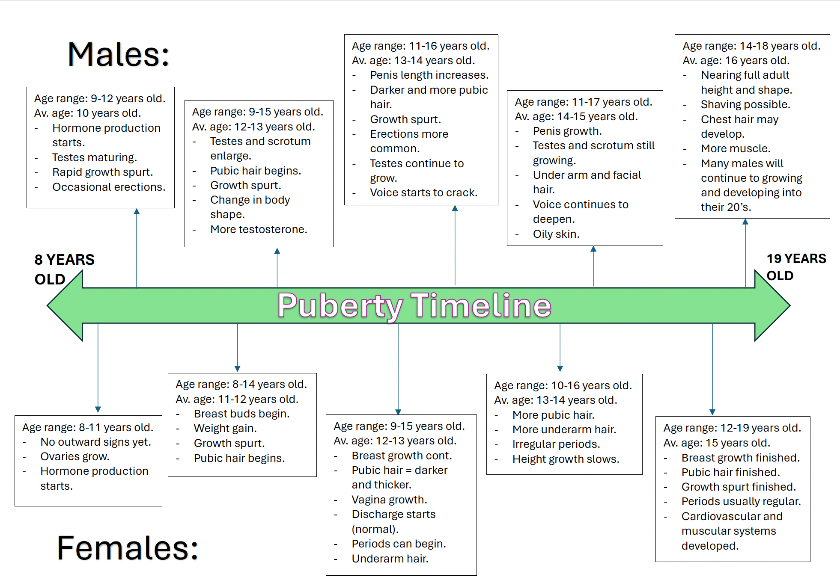

Slide 33
Remember…
Everyone has their own experience with puberty.
While it is something that everyone will go through, no two people are the same.
Our body’s will grow and begin to develop at different rates.
We are all unique.
Notes:
Emphasise that everyone has their own experience with puberty – no two people are the same and will progress at different speeds
Not in their workbooks.

Slide 34
3, 2, 1 R.I.Q:
Each person will receive a sticky note.
On your sticky note, complete the following:
- 3 x pieces of information you can RECALL from today
- 2 x things you found INTERESTING
- 1 x QUESTION you still have
Hand your note to your teacher on your way out.
Notes:
Resources – sticky notes.

Slide 35
Puberty
Year 7 Health – 2024
Lesson 6

Slide 36
Today’s focus
Label the female reproductive system.
Define the different parts of the female reproductive system.
Describe menstruation and ovulation.

Slide 37
(pg. 49)
In the first 5 minutes of each lesson, you will complete your revision page, you will find these throughout your booklet.
The revision page consists of three questions. It will need to be completed in detail. One-word answers will not be accepted.
The three questions :
What two concepts or ideas did I learn in class last week?
What did I find interesting about last week’s lesson? Provide a specific example.
Any questions or new words you have learnt?
The teacher will go over this each lesson with you to see what you have learnt. It is a great way for you to revisit content and test your memory.

Slide 38
HOOK: Quick quiz
QUESTIONS:
What is the primary MALE sex hormone?
What is the primary FEMALE sex hormone?
List 2 parts of the MALE reproductive system
List 2 parts of the FEMALE reproductive system
What is 1 emotional change that occurs during puberty?
What is the purpose of puberty?
What are hormones?
A question will be read aloud.
If you think you know the answer, raise your hand.
A person who has their hand up will be chosen at random to answer.
A new person will be selected if the answer is incorrect.
Keep your hand up if your answer was correct.
Lower your hand if your answer was incorrect.
Notes:
OPTIONAL HOOK #1
RELEVANT TO TEST
ANSWERS:
What is the primary MALE sex hormone?
Testosterone
What is the primary FEMALE sex hormone?
Oestrogen
List 2 parts of the MALE reproductive system
Testes, penis, prostate gland, seminal vesicle, epididymis, vas deferens
List 2 parts of the FEMALE reproductive system
Ovaries, vagina, fallopian tubes, uterus
What is 1 emotional change that occurs during puberty?
Romantic feelings towards others, changes in self-confidence and self-esteem, may feel self-conscious about our body and appearance, want to challenge authority/rebel, want to have new experiences etc.
What is the purpose of puberty?
To become capable of reproduction
What are hormones?
Chemical messengers that tell our body what to do

Slide 39
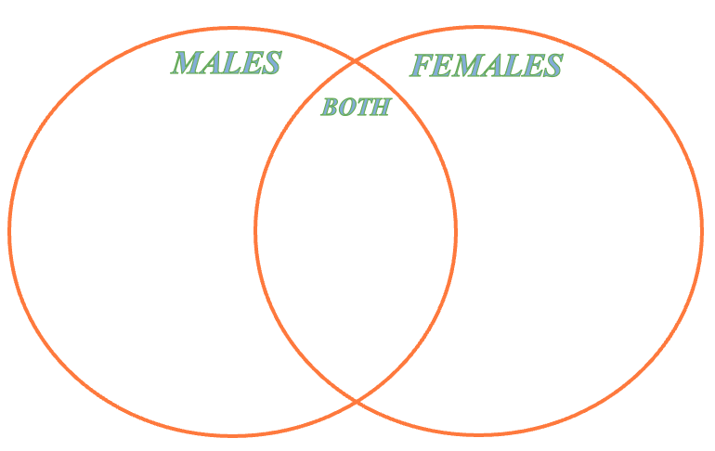
Activity 1: CHANGES RECAP (pg.50)
Complete the Venn diagram outlining some of the changes that occur during puberty.
Distinguish the changes that occur to males, females and both.
You can work with those around you, and you can refer to your work from previous lessons if you need help.
Consider PHYSICAL, SOCIAL & EMOTIONAL changes that occur during puberty.
You have 5 minutes ONLY.
Notes:
OPTIONAL HOOK #2 / CHANGES ARE RELEVANT TO TEST
This activity is purely a recap. 5 minutes only.
Can award a prize for the student(s) who have the most answers written down.
Up to the teacher if you would like students to complete activity individually or in pairs/groups.

Slide 40
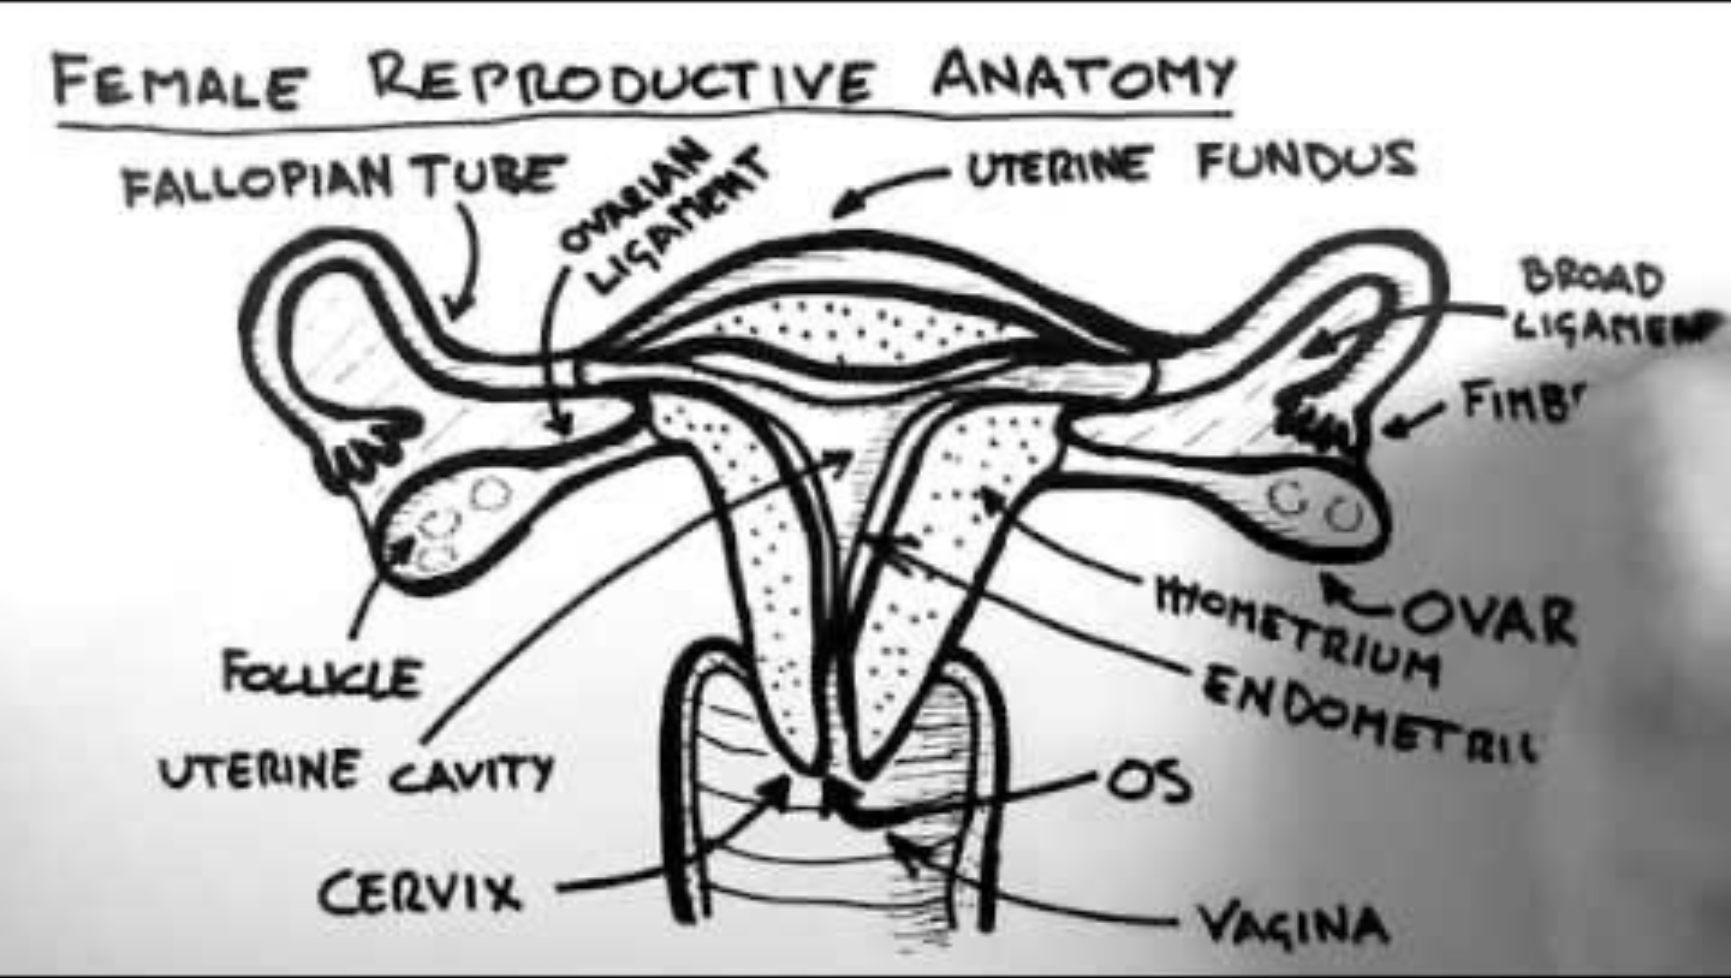
Notes:
Start at 0:28sec
4:45mins
https://www.youtube.com/watch?v=toKp0SGyv5w

Slide 41
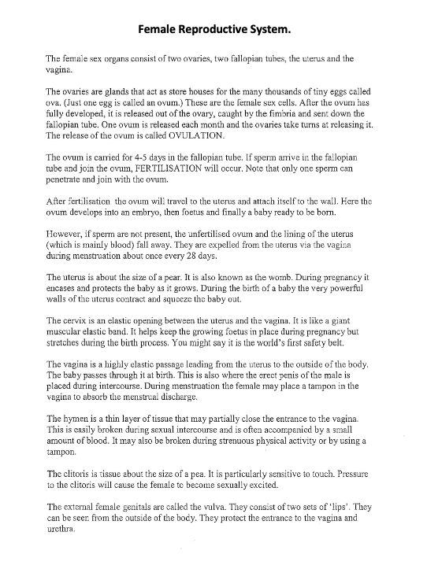
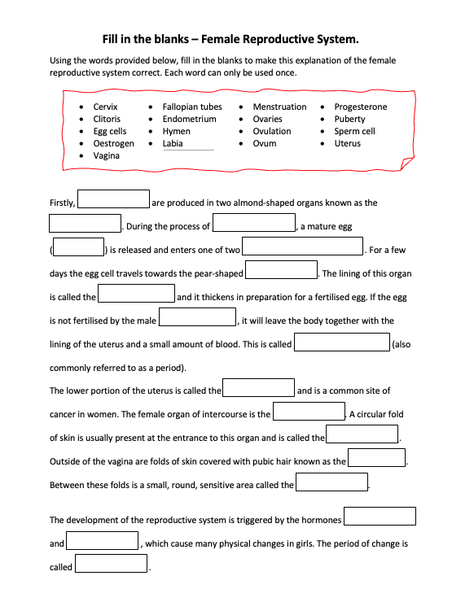
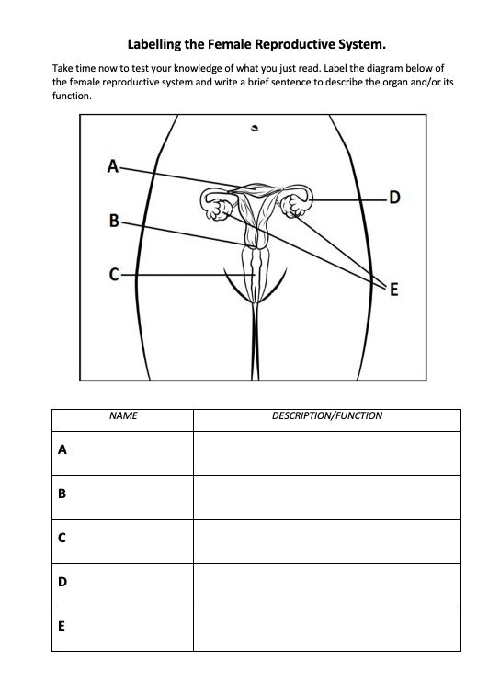
Activity 2: (pg.51-53) Female Reproductive System
Read the information about the female reproductive system on pg.51.
Use that information to help you fill in the blanks on pg.52.
Test your knowledge and have a go at labelling the female reproductive system image on pg.53 and fill in the function/description of each.
You have 12 minutes.
Notes:
RELEVANT TO TEST
ALTERNATIVE:
- read pg___ as a class and fill in the gaps together.
Go over answers as a class.

Slide 42
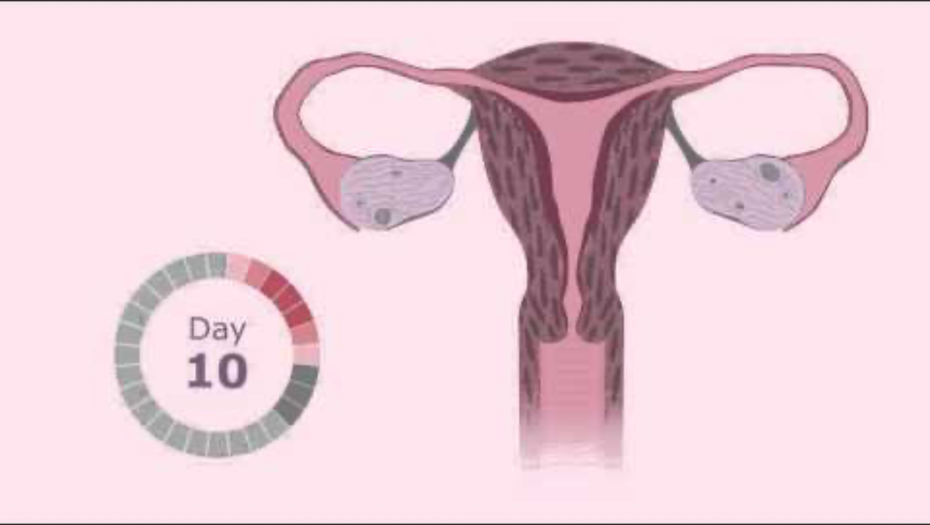
Notes:
2:05min
https://www.youtube.com/watch?v=vXrQ_FhZmos&t=5s

Slide 43
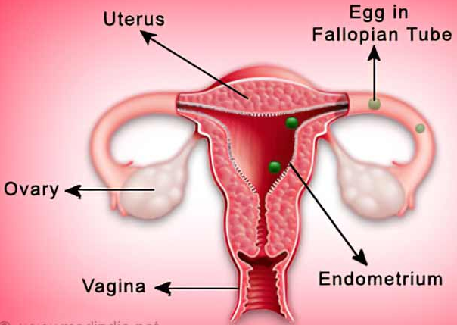
Ovulation (pg.54)
Girls are born with hundreds of tiny eggs. One egg is called an ovum, multiple eggs are called ova.
They mature and develop in the ovaries (singular = ovary).
At puberty, hormones tell the ovaries that it’s time to start releasing ova/eggs.
Usually, one egg at a time matures (develops) and is released from an ovary.
This release of the ovum from the ovary is called ovulation.
Ovulation occurs on average once a month.
Notes:
RELEVANT TO TEST
Fill in the blanks.

Slide 44
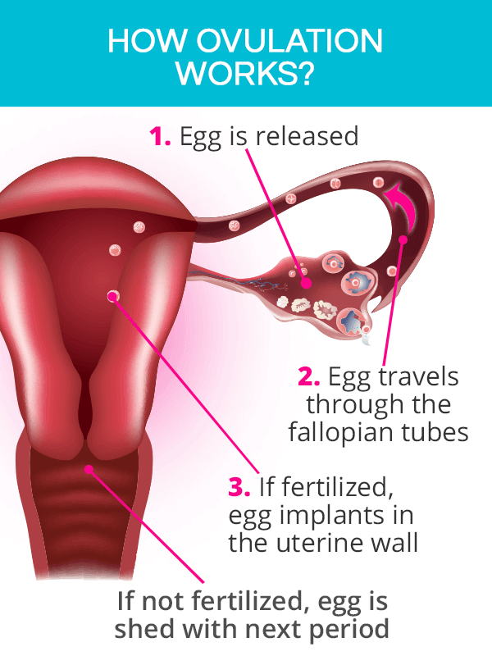
Ovulation continued… (pg.54)
At the same time, the uterus starts to grow a thick lining on the inside wall.
This uterine lining is called the endometrium.
The endometrium/uterine lining has lots of tiny blood vessels.
The lining is there to protect and feed an ovum that has combined with a sperm to form a fertilised egg.
Notes:
RELEVANT TO TEST
Fill in the blanks.

Slide 45
MENSTRUATION (pg.55)
If an ovum/egg does not meet a sperm, the endometrium (lining of the uterus) is not needed.
It breaks up – mixed with some blood, it comes out of the uterus, through the vagina and then out of the body through the vaginal opening.
This process is called menstruation.
It is also commonly referred to as a period.
If a woman is not pregnant, then her ovary will continue to release an ovum, the endometrium will build up and she will have her period. This will continue to occur if the egg is not fertilised.
The repetition of this cycle is called the menstrual cycle. On average it occurs every 28 days.
Notes:
RELEVANT TO TEST
Fill in the blanks.

Slide 46
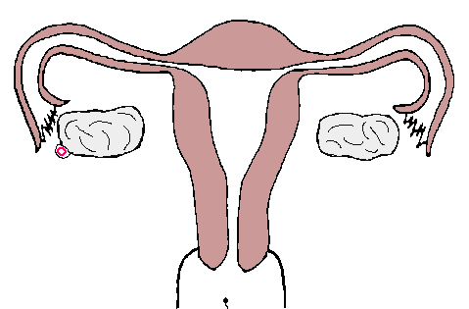
FERTILISATION/CONCEPTION (pg.55)
BONUS QUESTION!
Q: How many sperm does it take to fertilise an egg?
If a sperm fertilises an egg:
If an ovum is successfully fertilised by a sperm, this occurs in the fallopian tube. The fertilised ovum will move and begin to implant into the lining of the uterus – the endometrium.
The process of a sperm fertilising an egg/ovum is called conception.
The endometrium provides the fertilised egg with the environment that it needs to develop into a baby.
Approximately 9 months later a baby will be ready to be born.
A: only ONE!
Q: What about in the case of multiple births?
i.e., twins and triplets etc.
identical and fraternal.
A:
Identical twins = one sperm with one egg that split.
Fraternal twins = two eggs, two sperm (one sperm per egg)
Notes:
RELEVANT TO TEST
Fill in the blanks.

Slide 47
The menstrual cycle
Most girls get their period when they are between 10 – 15 years old.
The average age is 12, but it is not uncommon for girls to begin their period earlier or later than this.
The length of the menstrual cycle varies from person to person, but on average a woman will have her period every 28 days.
Regular cycles that are 23-35 days in length can be normal, if that is what is regular and normal for the female.
It is important to note that all girls will have different experiences with their period – just like with everything else about puberty, no two people are the exact same.
Notes:
RELEVANT TO TEST
Discuss – Information is not in their books. They could add it to the ‘additional notes’ section on the bottom of page 56.

Slide 48
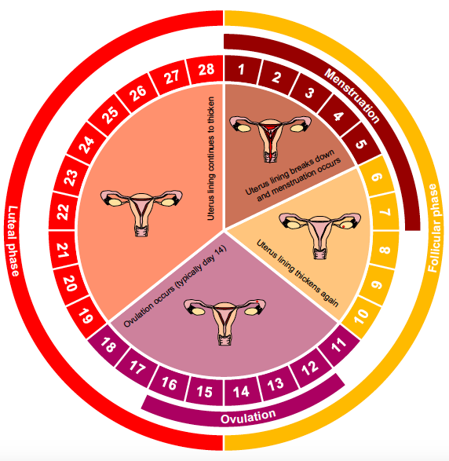
Menstrual Cycle (pg.56)
The menstrual cycle occurs monthly if an egg is not fertilised and pregnancy does not occur.
It comprises of different phases:
Follicular Phase
Occurs from day 1 – 14
Luteal Phase
Occurs from day 15 – 28
Menstruation
Occurs during days 1 – 7
Ovulation
Occurs during days 12 – 16
Notes:
Explain the phases and what occurs during each phase.
Diagram is also in their books.

Slide 49
GLOSSARY: (Pg. 5)
At the front of your books is your glossary. Turn to your glossary and add the following words and their definitions:
Menstruation
The normal vaginal bleeding that occurs as part of a woman's monthly cycle.
Each month a woman’s body prepares for pregnancy. If this does not occur, they have their period.
Ovulation
The phase of the female menstrual cycle that involves the release of an egg (ovum) from one of the ovaries.
Ovum
The female sex cell (also known as the egg) formed in the ovaries and contains the female DNA.
Ovum = singular.
Ova = plural.

Slide 50
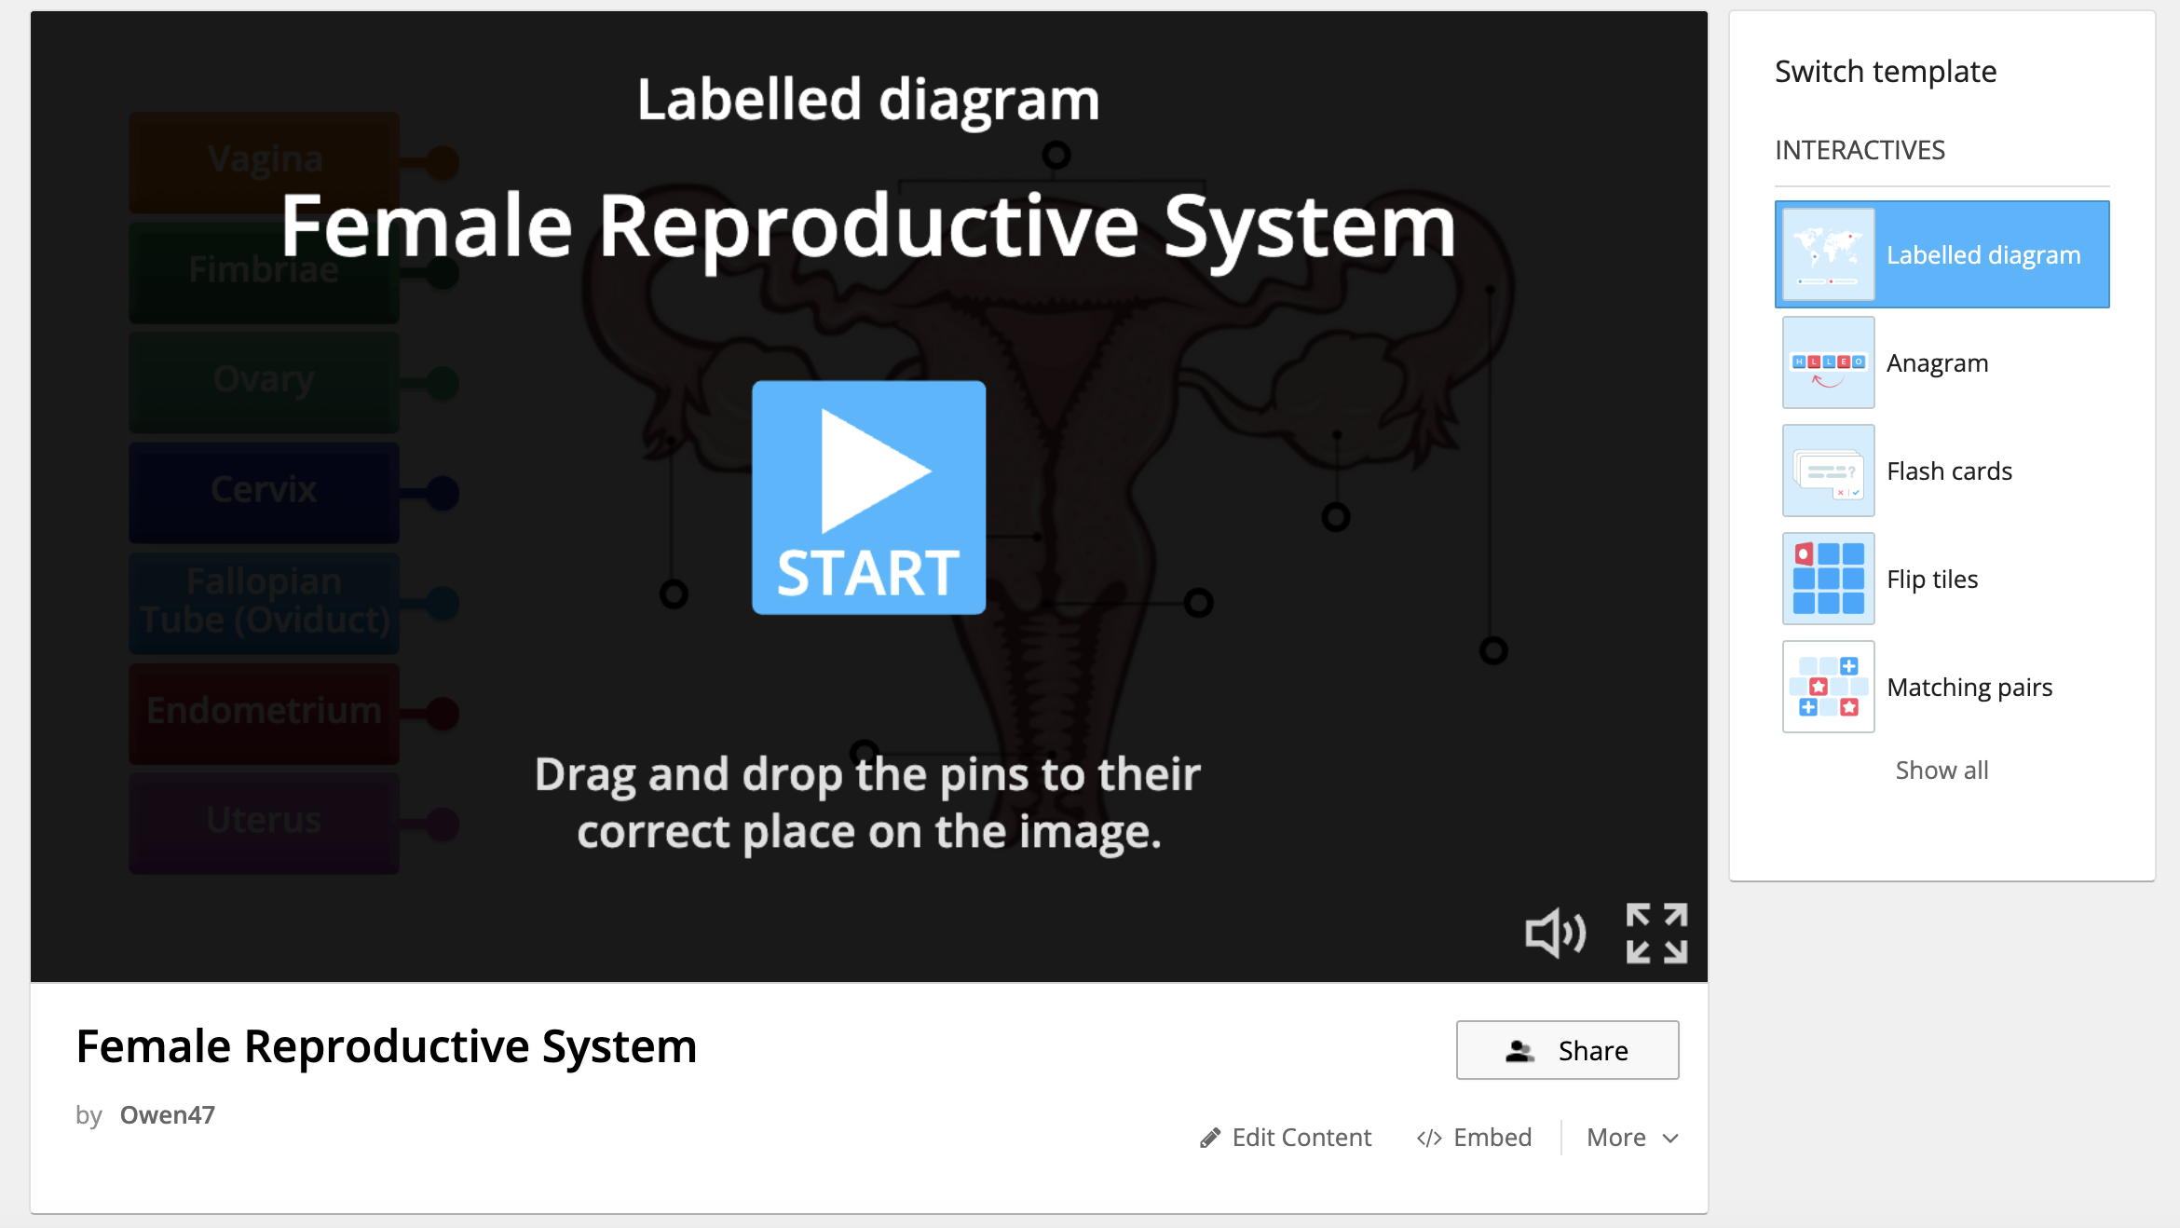
Activity 3: REFLECTION Test your knowledge… (pg.56)
Visit: https://wordwall.net/resource/27628547
Complete the activity to label the diagram of the female reproductive system.
Once you have completed the diagram activity, complete the anagram activity.
You have 5 minutes to have a go at these activities.
Notes:
OPTIONAL
Link is also in their books to click on.
https://wordwall.net/resource/27628547

Slide 51
Puberty
Year 7 Health – 2024
Lesson 7

Slide 52
Today’s focus
Label the female reproductive system.
Define the different parts of the female reproductive system.
Understand the menstrual cycle, symptoms and how to manage it.
Discuss hygiene and how to be hygienic.

Slide 53
(pg. 57)
In the first 5 minutes of each lesson, you will complete your revision page, you will find these throughout your booklet.
The revision page consists of three questions. It will need to be completed in detail. One-word answers will not be accepted.
The three questions :
What two concepts or ideas did I learn in class last week?
What did I find interesting about last week’s lesson? Provide a specific example.
Any questions or new words you have learnt?
The teacher will go over this each lesson with you to see what you have learnt. It is a great way for you to revisit content and test your memory.

Slide 54
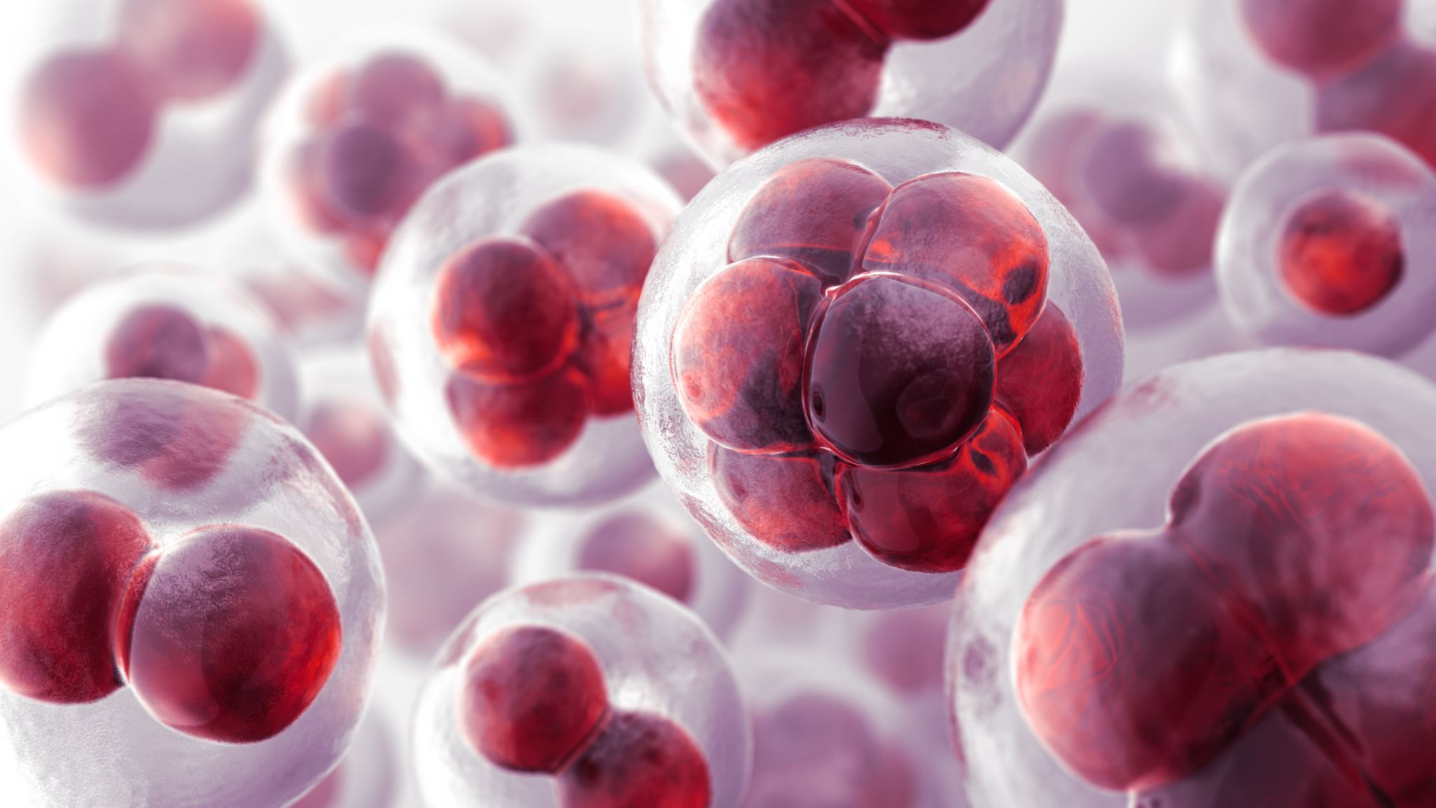
Ovulation & Menstrual Cycle review:
Hormones tell the ovaries to start releasing ova (a.k.a eggs. Singular = ovum, plural = ova).
One egg is released from one ovary each month.
The egg travels through the fallopian tube into the uterus.
In the uterus the endometrium develops a rich blood supply to support a developing baby.
If it is not fertilised by a sperm, then the endometrium leaves the body, through the vagina, through the process of menstruation (a.k.a period).
This cycle is called the menstrual cycle and repeats, on average, every 28 days.
If the egg is fertilised, then it implants into the uterus and a baby will develop.
Notes:
RELEVANT TO TEST
Review. This is not written in their books.

Slide 55
GLOSSARY: (Pg. 5)
At the front of your books is your glossary. Turn to your glossary and add the following words and their definitions:
Premenstrual Syndrome (PMS)
A set of physical, emotional and behavioural symptoms that occur in the 1-2 before menstruation.
Symptoms typically begin in the 5 days before menstruation and end within 4 days after the bleeding starts.

Slide 56
PMS & Period Symptoms (pg.58)
As mentioned, no two people are the same and no two females will have exactly the same experience with their period.
There are some signs and symptoms that may occur before or during a girl's period.
Premenstrual Syndrome, also known as PMS, is a set of physical, emotional and behavioural symptoms that occur during the last week of the luteal phase (1-2 weeks before menstruation). PMS can also be referred to as PMT, or Premenstrual Tension.
PMS symptoms typically start in the 5 days before menstruation begins and ends within 4 days of the bleeding starting.
Notes:
RELEVANT TO TEST
Read through – also in their workbooks.

Slide 57
Activity 1a: PMS & Period Symptoms (pg.58)
If PMS symptoms can be physical, emotional and behavioural… what could they be?
One minute to discuss: what symptoms a female may experience during her menstrual cycle?
Examples of PMS symptoms and period symptoms include:
Ways to manage the symptoms include:
Exercise
Eat well
Get enough sleep
Stress reduction techniques
Pain medication (Panadol, nurofen etc.)
Heat pack
Keeping a diary of symptoms may also be beneficial to keep track of feelings and if things change.
Cramps
Bloating
Acne/pimple breakouts
Breast tenderness
Headaches
Mood swings
Feeling more irritable, upset or anxious
Tiredness or trouble sleeping
Appetite changes
Notes:
Write the examples of PMS into their books and ways to manage.
Possibly worth mentioning:
Take this opportunity to mention that there are conditions related to the female reproductive system:
Endometriosis – affects the endometrium/uterine lining, where the uterine lining grows outside of the uterus. It can cause severe pain and discomfort and impact fertility.
Polycystic Ovarian Syndrome (PCOS) – a hormonal condition which impacts the regularity of the menstrual cycle and fertility, amongst the possibility of other symptoms.
This is why keeping a diary could also be effective if a person starts to experience changes, or more painful or irregular periods as it could be a sign of something else going on.

Slide 58
BONUS QUESTION!
Q: Why is it important for MALES to ALSO be aware of the menstrual cycle, menstruation and PMS?
A: We all have females in our life in some capacity – friends, siblings, family, peers, colleagues, bosses etc.
It can be helpful as it can allow everyone to understand what someone may be going through a little bit better. Periods and PMS can effect everyone differently from person to person, or even from month to month. Females don’t have automatic control over their hormones so navigating all of this can be tricky at times.
The same can be said for females and needing to know about the male reproductive system and male puberty.
It can be a tricky and confusing time for anyone so by increasing our knowledge and understanding can help us to be kinder and more empathetic towards each other, therefore establishing more positive relationships with those around us.
Notes:
Optional to award a prize for the best response to this question.

Slide 59
How to manage Menstruation (pg.59)
Tampons: a small plug of material that fits inside the vagina to absorb blood.
Pro’s: can go swimming, can be more comfortable, available in different sizes, can get tampons with an applicator for easier insertion, easy to pack/transport.
Con’s: takes practice to be able to use one comfortably, needs to be changed regularly, toxic shock syndrome.
Pads: a sanitary pad stuck on the inside of the underwear to absorb and catch the blood.
Pro’s: easy to use, comes in a variety of shapes and sizes, good when learning your cycle.
Con’s: need to be changed regularly, can be uncomfortable, outline and shape can show when wearing tight fitting clothing, can’t swim in them.
Period Underwear: underwear that contains a moisture-wicking fabric to absorb the blood.
Pro’s: environmentally friendly (compared to pads and tampons), easy to use, comfortable, come in different styles and absorbency.
Con’s: must be washed straight away, must buy the correct size.
Menstrual Cup: a small, flexible cup that is inserted into the vagina to catch the blood.
Pro’s: can be used for 8-12 hours at a time, comes in different shapes and sizes, most environmentally friendly method, cost effective, hold more blood than a pad/tampon, easy to use once comfortable, less odour.
Con’s: takes practice to be able to use correctly and comfortably, can take time to find the right fit, removal can be messy, need to be washed after every use.
Notes:
All of this is written in their books for their reference.
Optional resource – use the sanitary kits in the storeroom.
Your choice how much time you spend on this.

Slide 60
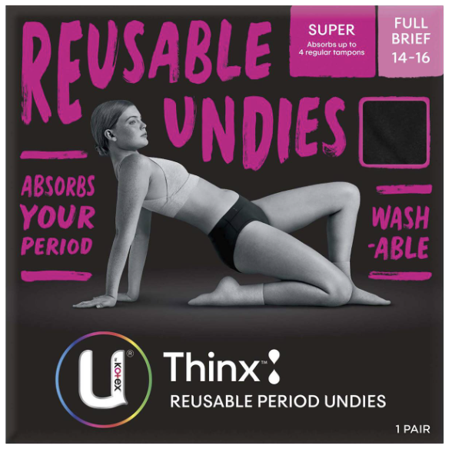
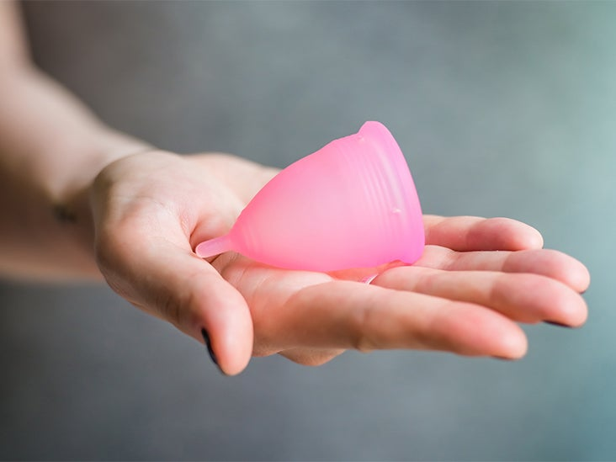
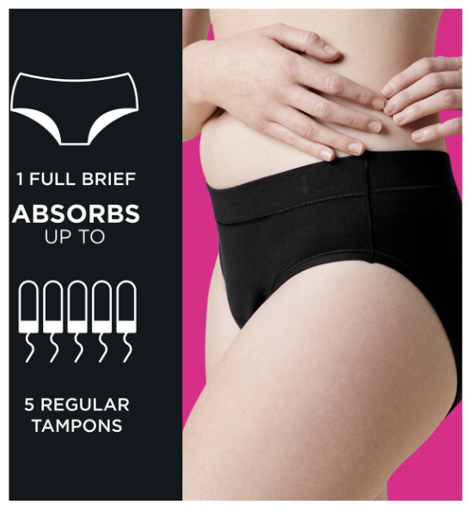
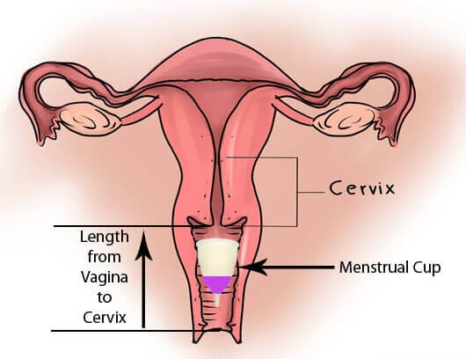
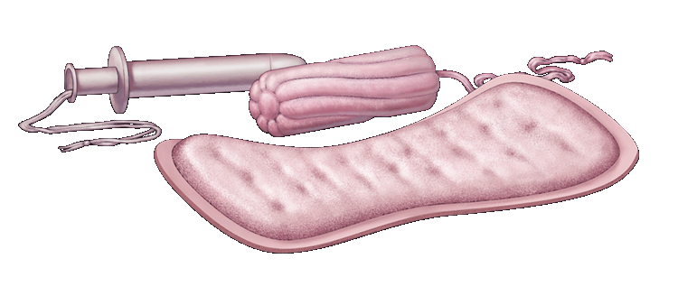
Period Underwear
Menstrual Cups
Tampons
Pads
Notes:
These images are also in their books for their reference.

Slide 61
Activity 1B: MYTH OR FACT? (PG.59)
MYTH = STAND FACT = SIT
A female can’t use a tampon until they’re 17 because their vagina is too small.
You can’t push a tampon so far up that it will get lost in your body.
Tampons cause cancer of the uterus.
A female can feel a tampon when it is worn correctly.
Tampons and pads can be changed depending on flow and comfort.
A person can’t go to the toilet normally when wearing a menstrual cup.
A female can swim while wearing a tampon or a menstrual cup.
Period underwear is a standalone solution for managing menstrual flow.
MYTH
FACT
MYTH
MYTH
FACT
MYTH
FACT
FACT
Notes:
OPTIONAL ACTIVITY

Slide 62
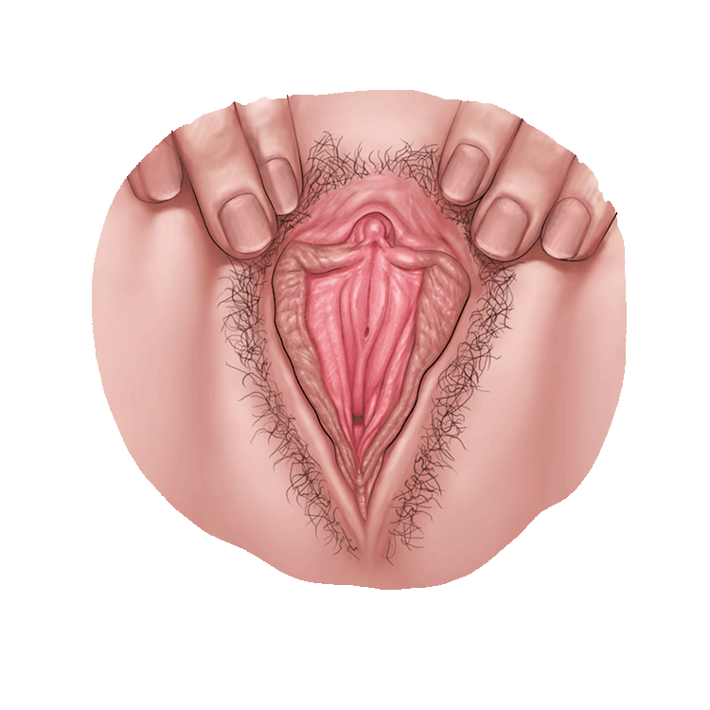
What are the female sex organs?
These parts are also called the reproductive organs and genitals.
The parts on the outside are:
Vulva
The area of soft skin between a female’s legs.
Clitoris
Small organ made of nerves and tissue.
At the top where the lips join.
Only the tip is on the outside, the rest is hidden inside.
Sensitive to touch. Can feel tingly and pleasurable.
Labia
Soft folds of skin that cover the inner parts
Grow darker and bigger at puberty.
Notes:
RELEVANT TO TEST
Read through information.

Slide 63
What are the female sex organs?
Urethra
Not a sex organ.
Tiny opening that urine comes out from the bladder.
Vaginal opening
Entrance to the vagina.
Hymen
Thin piece of skin that may cover part of the opening to the vagina.
Often small or missing.
Anus
Between the two cheeks of the buttocks.
It is where bowel movements come out.
Notes:
RELEVANT TO TEST
Read through information.

Slide 64
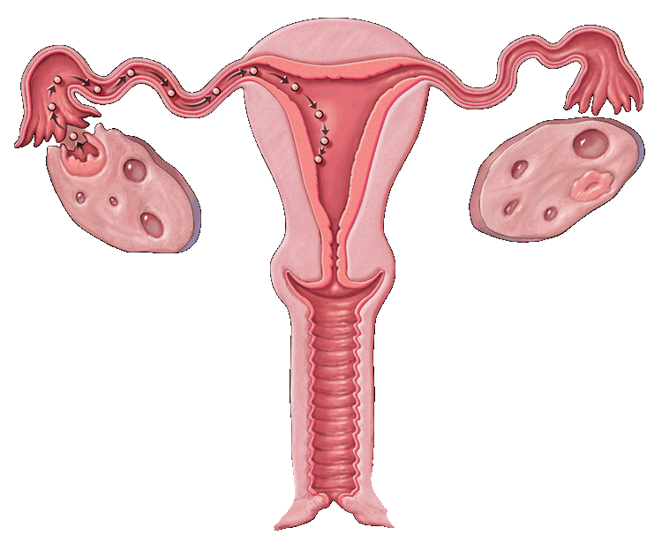
The parts on the inside are…
Uterus
Sometimes called the womb.
Muscular organ about the size of a pear.
Where developing baby, called a fetus, grows and is fed.
Where the period comes from.
Vagina
the muscular tube leading from the external genitals to the cervix of the uterus
Notes:
RELEVANT TO TEST
Read through information.

Slide 65
The parts on the inside are…
Fallopian tubes
Narrow tubes between the uterus and the ovary where the ova travels.
Ovaries
Glands that make egg cells and female sex hormones.
Cervix
The lower part of the uterus.
Makes mucus to keep sperm alive.
Has opening through which menstrual fluid can pass out of the uterus or sperm can enter.
Notes:
RELEVANT TO TEST
Read through information.

Slide 66
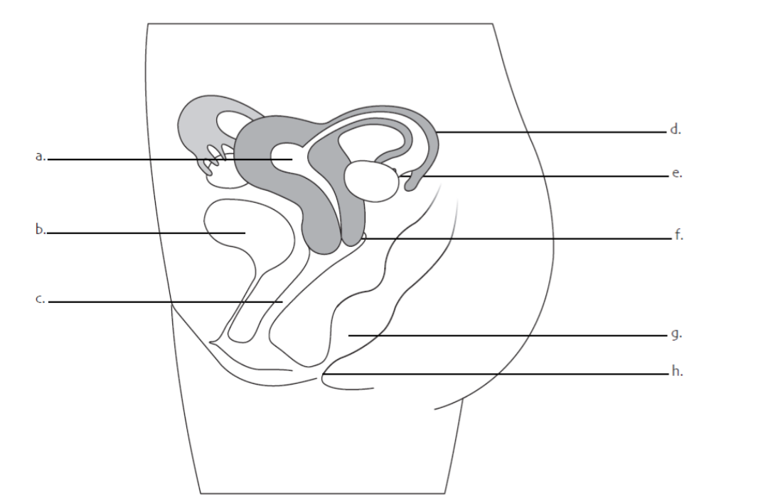
Activity 2: Label the Female Reproductive system (pg.60)
Read the definitions of the female reproductive system in your workbooks.
Use the words to label the diagram of the female reproductive system.
Use your knowledge of the menstrual cycle and the organs involved to help with your labelling.
You have 4 minutes.
Notes:
RELEVANT TO TEST – this diagram will appear in their test.
They should also be aware of the definitions.
There is a FAQ’s page in their workbooks on pg___

Slide 67
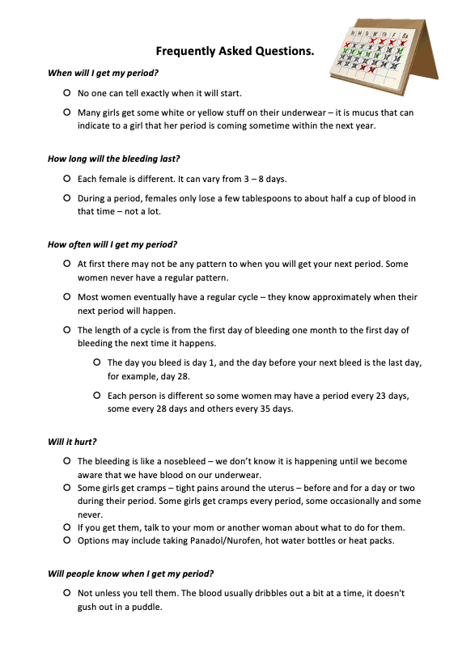
FAQ’s
On page 61 you can find some extra questions and answers related to females and their periods.
Pages 62-65 also contain extra information regarding the menstrual cycle.
Notes:
Students can peruse this in their own time, just make them aware of it.

Slide 68
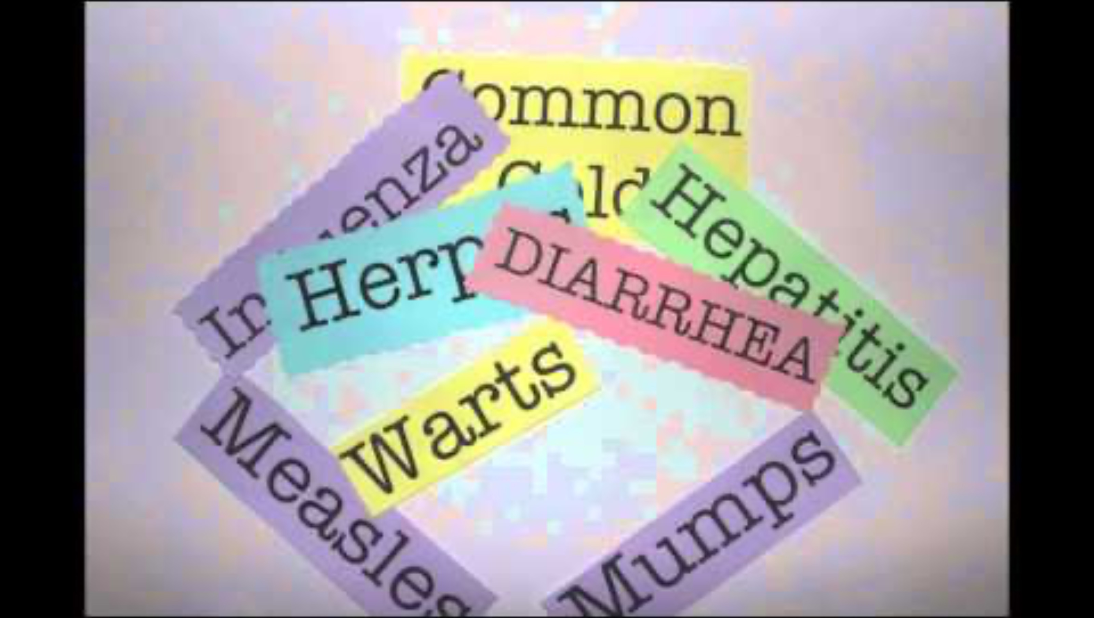
HYGIENE (pg.66)
Maintaining hygiene is important at any stage of life, especially during puberty when our bodies are changing so much.
While watching the video, identify and describe 3 ways you can be hygienic every day.
Notes:
3:57mins
OPTIONAL – can get away with not watching the video.
https://www.youtube.com/watch?v=8ENl6yhTahg

Slide 69
HYGIENE – RAPID FIRE (PG.67-70)
RAPID FIRE!! – Raise your hand to answer:
What are some changes that occur during puberty that could cause hygiene problems for BOTH girls and boys?
What are some hygienic things we can do regularly to help us stay fresh?
Read through the information in your books on pages 67 – 70 and answer the questions.
You have 8 minutes.
Bad breath
Body odour
Increased sweat
Acne/oily skin
Oily hair
Clean our teeth 2x daily
Wear deodorant
Shower daily
Wash our face
Wash our hair
Notes:
Answers for acne self-help strategies on pg.68 are discussed over the next few slides.
Priority pages are pg.67-68 (the first two pages). The other pages are a bit more of a puberty recap (69-70).
Spend whatever time is left of the lesson completing the pages.

Slide 70
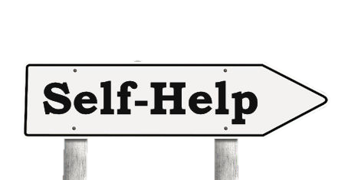
Acne & Self-Help Strategies (pg.68)
How can the following factors effect acne and what can you do to help manage acne?
Washing
Squeezing
Stress
Diet

Slide 71
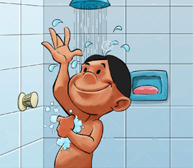
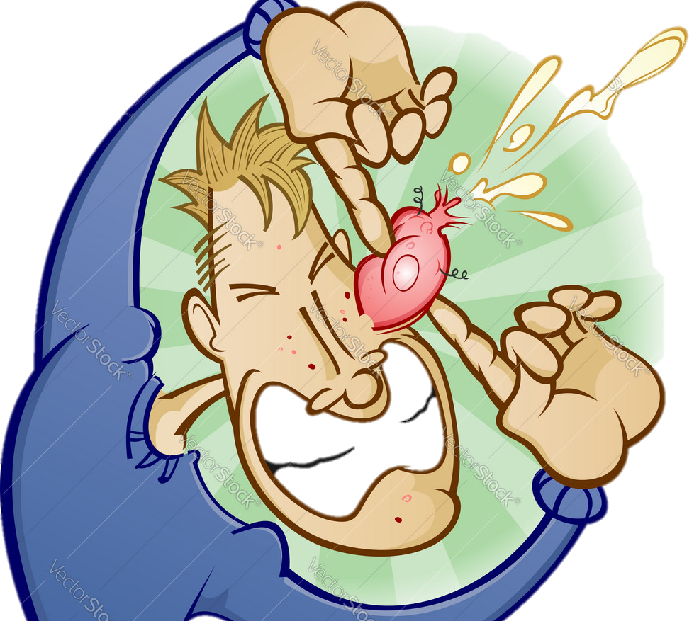
Self-Help: (pg.68) washing & Squeezing
WASHING:
Cleaning the skin can help, but even people with very clean skin can have problems with acne.
Try washing the affected areas twice per day (morning and night).
Don’t overdo it. Too much washing can cause other skin problems, such as dryness or skin irritations.
Try to keep hair clean and off the face and neck, as oil from the hair can make acne worse.
Young people going through puberty don’t need to use lots of expensive products as their skin is still delicate and can be sensitive.
SQUEEZING:
Don’t squeeze!
Picking and squeezing pimples can get germs into the skin around the pimple and make it worse.
It can also lead to scarring of the skin.
Notes:
Help to answer acne self-help questions.

Slide 72

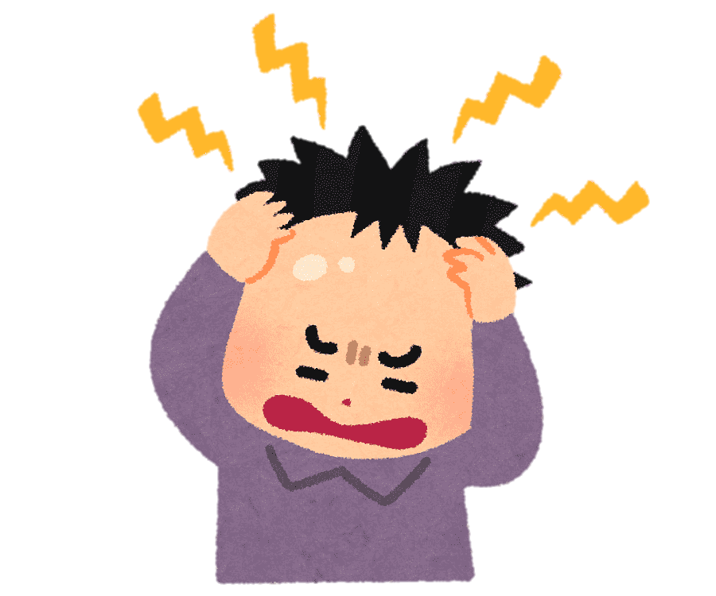
Self-Help: (pg.68) STRESS & DIET
STRESS:
This can trigger an outbreak of pimples as it causes the release of chemicals into the brain that can make oil glands release more oil onto the skin.
This is why pimples seem to magically appear on stressful days, such as at the time of an exam or special date.
While stress may be difficult to control, at least you know that the outbreak is due to stress, not a sign that the treatments do not work.
Try to practice stress management techniques that work for you (e.g. exercise, journaling, meditation etc.)
DIET:
Many people think that lollies or chocolate cause pimples.
Research has not shown any strong link, but some people find that it works this way for them, so if you notice that eating certain foods like chocolate cause pimples for you, try avoiding them.
Notes:
Help to answer acne self-help questions.

Slide 73
EXIT TICKET:
Turn to your partner and answer the question:
DESCRIBE TWO PARTS OF THE FEMALE REPRODUCTIVE SYSTEM

Slide 74
Puberty
Year 7 Health – 2024
Lesson 8

Slide 75
Today’s focus
Label the male reproductive system.
Define the different parts of the male reproductive system.
Describe the journey of the sperm.
Describe the journey of an ovum.

Slide 76
(pg. 71)
In the first 5 minutes of each lesson, you will complete your revision page, you will find these throughout your booklet.
The revision page consists of three questions. It will need to be completed in detail. One-word answers will not be accepted.
The three questions :
What two concepts or ideas did I learn in class last week?
What did I find interesting about last week’s lesson? Provide a specific example.
Any questions or new words you have learnt?
The teacher will go over this each lesson with you to see what you have learnt. It is a great way for you to revisit content and test your memory.

Slide 77
TRUE OR FALSE?
TRUE = STAND FALSE = SIT
The sun is good for your skin and slows down aging.
Stress can contribute to skin problems.
Perfumes are the same as antiperspirants and help stop body odour developing.
Diet is a major contributing factor for acne.
Body odour starts to increase during puberty.
We only have sweat glands under our arms.
Males tend to produce more sweat than females.
MYTH
FACT
MYTH
MYTH
FACT
MYTH
FACT
Notes:
OPTIONAL ACTIVITY
The sun can aggravate acne and speeds up the process of aging and can cause skin cancer.
Stress doesn’t cause pimples, but it can make them worse.
Perfumes and deodorant mainly help to mask or cover up B.O. Antiperspirants help to stop B.O from developing by reducing underarm wetness.
It is now believed that diet is not a cause of acne. However, for some people it may contribute. A well balanced diet is beneficial for our overall health and well-being.
Specific glands become active during puberty which produce perspiration (sweat), which when mixed with the bacteria on our skin can cause body odour.
Sweat glands are everywhere on our body, except lips and ears. Each person has about 2.5million.
Males tend to produce more sweat than females (on average).

Slide 78
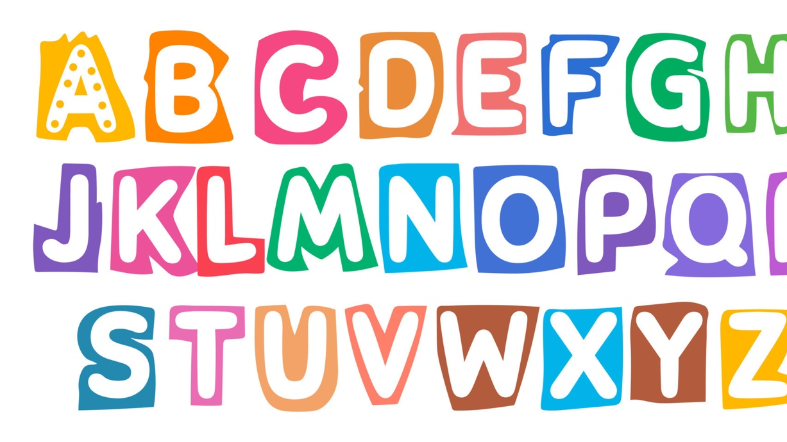
Hook: Alphabet RACE (pg.72)
Individually, complete the Alphabet Race in your workbooks.
Write ONE WORD that relates to the topic of puberty that begins with each letter of the alphabet.
Be prepared to share your answers.
You have 5 minutes.
Notes:
OPTIONAL ACTIVITY
First person who is successful can win a prize/person with the most answers at the end of the time wins a prize.
Topics to think of – labelled parts of the body, different names for things, physical/social/emotional changes
Suggestions: G – gonads
I – individuality
J – jealousy
K – kinky, kids
Q – queer
X – X chromosome
Y – Y chromosome
Z – zest (for life 🤷🏼‍♀️)

Slide 79
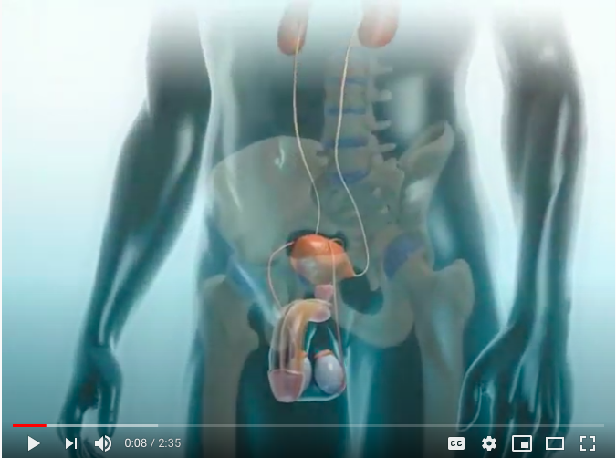
Male reproductive system
https://www.youtube.com/watch?v=nr5W9trSv8I
Notes:
OPTIONAL
Click the link below to watch the video
https://www.youtube.com/watch?v=nr5W9trSv8I

Slide 80
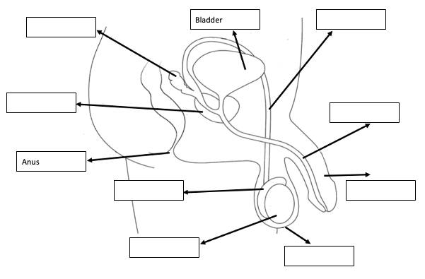
What are the male sex organs? (pg.73)
Reproduction is the process by which organisms make more organisms like themselves. But even though the reproductive system is essential to keeping a species alive, unlike other body systems, it's not essential to keeping an individual alive.
As previously discussed, the whole point of the male and female reproductive systems it to allow us to reproduce and create a baby.
The male reproductive system is made up of different parts.
Like in females, hormones trigger the development of these organs.
The primary male hormone is testosterone.
Notes:
Use the information and definitions over the next slides to help

Slide 81
Activity 1: What are the male sex organs? (pg.73)
Follow along with the information on the following slides to assist you in labelling the male reproductive system.
For the remaining spaces, read through the definitions in your workbook to complete your labelled diagram.
Notes:
RELEVANT TO TEST – this diagram is in their test.
Use the information and definitions over the next slides to help.

Slide 82
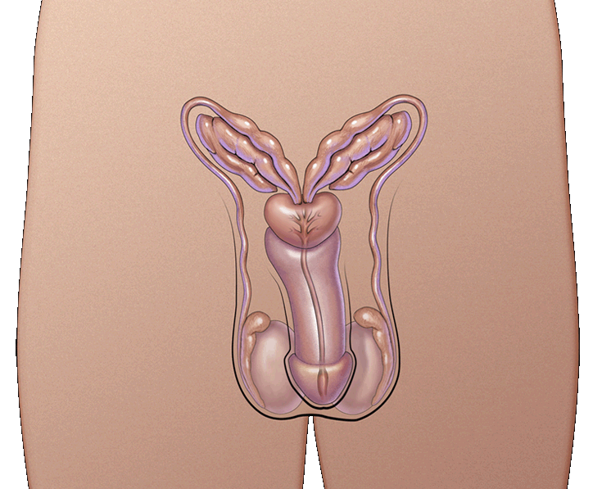
What are the MALE sex organs?
These parts are also called the reproductive organs and genitals
The parts are:
Urethra
Penis
Testicles or Testes
Scrotum
Notes:
RELEVANT TO TEST
Discuss

Slide 83
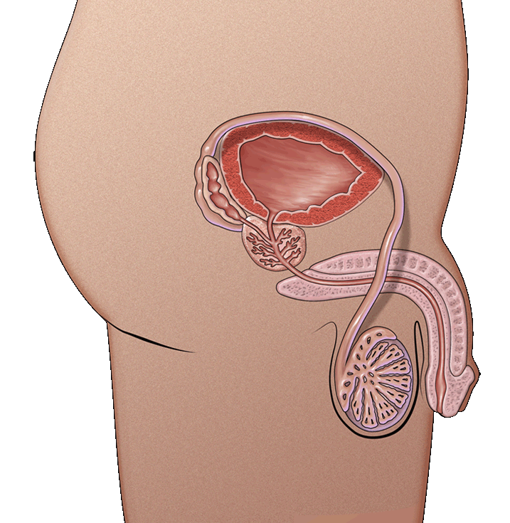
What are the MALE sex organs?
Urethra
the tube through which urine and semen leaves the boy’s body
Penis
tube-like organ that hangs outside the body
come in all sizes and shapes, determined by our genes
Testicles or testes
usually two, one hangs lower
Sometimes called balls or nuts
Where sperm are made
Scrotum
bag of skin that holds testicles
keeps them at right temperature to make sperm, slightly cooler than body’s temperature
gets bigger and baggier and turns a darker colour
Foreskin
Roll of skin covering the end of the penis.
This skin can be removed through the process of circumcision.
Notes:
RELEVANT TO TEST
Discuss (touch on circumcision --> T/F section of test)

Slide 84
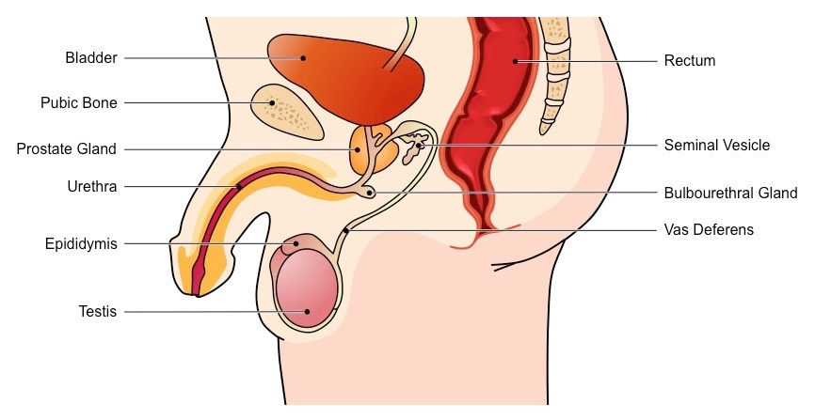
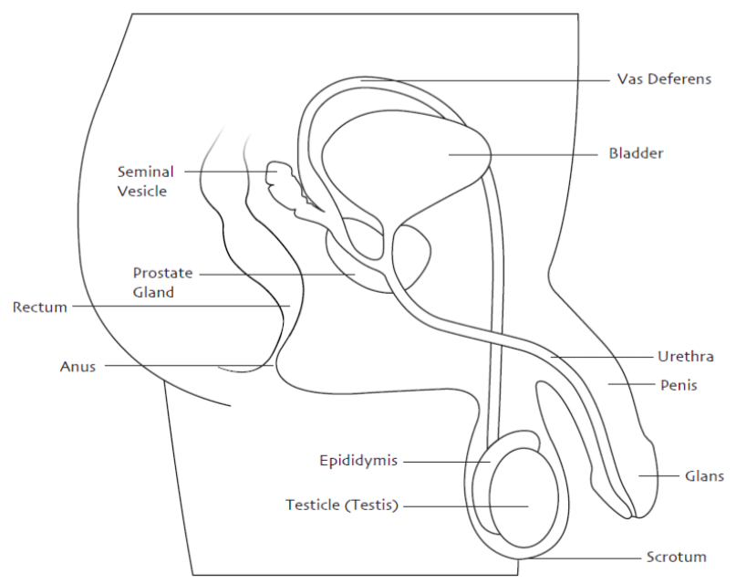
Notes:
Answers

Slide 85





Activity 2: Research Walk – Male Reproductive system (pg.74-75)
Around the room are different posters with information about puberty and the male reproductive system.
Walk around the class and use each poster to help you answer the relevant questions.
You have 20 minutes.
Notes:
Ways to run this activity:
(can change the slide information to suit how you are going to run the class if you want/need to)
Research walk: Place the posters around the room on different walls. Students walk around the room to read the posters and complete their work. Allocate 15-20 minutes to complete the questions and go over answers as a class (these instructions are explained on the slide). Put a timer on the screen.
Pros – allows students to walk around and mingle.
Cons – could be difficult if you have a silly class.
Group work: Have students working in 5 groups. Allow a 4-5 minutes to read the poster and answer the relevant questions. Rotate the posters around the class until each group has seen and used each poster to answer the questions. Put a timer on the screen.
Pros – allows students to mingle with others and work together.
Cons – more stationery for students. Could take longer to complete depending on how much time you allow for each poster.
Individually follow along: Go through the information on the slides and students fill in the work as you go.
Pros – could be completed quicker. Easier if you have a harder class who works better seated.
Cons – means more talking for the teacher and less student directed working.

Slide 87
Notes:
Click to reveal the Myths/Truths.

Slide 89
Males and females can both be sexually aroused, and both can orgasm.
Masturbation is the term used to describe the stimulation of one's own genitals.
For reproduction to be able to occur through sexual intercourse, an erection needs to happen.
Notes:
RELEVANT TO TEST
Discuss.

Slide 90
FUN FACT!
The scientific name for a wet dream is a Nocturnal Emission!
Nocturnal = at nighttime.
Emission = the discharge/release of something.
Notes:
RELEVANT TO TEST
(Nocturnal emission in MC)

Slide 91


Activity 3: Journey of a Sperm (pg.76-77)
Use your knowledge of the male reproductive system, and the diagram in your books to help you fill in the blanks to uncover the ‘Journey of a Sperm.’
You have 5 minutes to have a read and attempt to fill the blanks on your own, before we discuss the answers.
**Test your recall by not looking at your previous notes.**
Notes:
ALTERNATIVE:
Save time by going through it as a class all together instead of allowing students to have a go on their own.
Or, shorten the time allowed.
Optional to set as homework.

Slide 92


Activity 4: Journey of an OVUM (pg.78-79)
Repeat the previous activity and use your knowledge of the female reproductive system, and the diagram in your books to help you fill in the blanks to uncover the ‘Journey of an Ovum through menstruation.’
You have 5 minutes to have a read and attempt to fill the blanks on your own, before we discuss the answers.
**Test your recall by not looking at your previous notes.**
Notes:
RELEVANT TO TEST
ALTERNATIVE:
Save time by going through it as a class all together instead of allowing students to have a go on their own.
Or, shorten the time allowed.
Optional to set as homework.

Slide 93
GLOSSARY: (Pg. 5)
At the front of your books is your glossary. Turn to your glossary and add the following words and their definitions:
Erection
When a male is sexually aroused, blood rushes to the penis causing it to harden and enlarge.
Sperm
The male sex cell formed in the testes and contains the male DNA.
Ejaculation
The act of ejecting semen from the body.
Notes:
RELEVANT TO TEST

Slide 94

FAQ’s
On page 80 you can find some extra questions and answers related to the male reproductive system.
Notes:
Students can peruse this in their own time, just make them aware of it.

Slide 95

Activity 5: REFLECTION Test your knowledge… (pg.79)
Visit: https://wordwall.net/resource/31937101/changes-at-puberty-male-female
Complete the activity to sort the changes that happen to males and females during puberty.
You have 5 minutes to have a go at these activities.
Notes:
OPTIONAL
Link is also in their books to click on pg______
https://wordwall.net/resource/31937101/changes-at-puberty-male-female

Slide 96
Puberty
Year 7 Health – 2024
Lesson 9

Slide 97
Today’s focus
Revision for upcoming test.

Slide 98
(pg. 81)
In the first 5 minutes of each lesson, you will complete your revision page, you will find these throughout your booklet.
The revision page consists of three questions. It will need to be completed in detail. One-word answers will not be accepted.
The three questions :
What two concepts or ideas did I learn in class last week?
What did I find interesting about last week’s lesson? Provide a specific example.
Any questions or new words you have learnt?
The teacher will go over this each lesson with you to see what you have learnt. It is a great way for you to revisit content and test your memory.

Slide 99

Hook: (pg.82) PUBLIC & PRIVATE BODY PARTS
Our body is exactly that – OUR BODY.
We get to decide who has access to it and it what capacity.
Complete the worksheet in your books and reflect on what parts of your body you would consider public and private.
Notes:
OPTIONAL
Discuss this worksheet as a class and explain that they should never be made to do any activities with their body (particularly sexual) if they do not want to/do not consent to it.
If students are ever made to feel unsafe, then they should report it to a trusted adult.

Slide 100
Revision Options:
Revision booklet for students to work through.
Puberty Memory Game.
One class set located in the Health storeroom.
One pack of cards per group.
Place all cards face down on the table. Students flip a card over and read it and try and match it to its correct partner (question and answer).
Kahoot!
https://create.kahoot.it/share/the-joys-of-puberty/992434db-fbec-4c3e-8e22-d7c61f64b17a

Slide 101
Puberty
Year 7 Health – 2024
Lesson 10

Slide 102

TOPIC TEST
Separate all desks.
You need a pen.
No talking or cheating.
May result in a loss of marks/score of 0
If you finish early, raise your hand and your teacher will collect your test paper.
Notes:
Early finisher activity included in the lesson 10 folder.

Slide 103
Puberty
Year 7 Health – 2024
Lesson 11

Slide 104
Today’s focus
Review KWL from first week of puberty.
Watch ’Inside Out’

Slide 105
Puberty KWL REVIEW (pg.36)
Back in week 4, our first lesson on puberty, we completed a KWL
You completed the first two boxes of the KWL:
What do you already know about puberty?
What do you want to know about puberty?
Revisit your KWL and complete the last box:
What have you learned throughout the puberty unit?
You have 5 minutes to reflect and write as much as you can in the box.

Slide 106

YOUR Questions Answered
Q:
A:
Q:
A:
Q:
A:
Q:
A:
Notes:
OPTIONAL – use this slide as a way of answering your question box questions during lessons.
Write the question, followed by the answer on the slide so students can read and follow along.

Slide 107
YOUR Questions Answered
Q:
A:
Q:
A:
Q:
A:
Q:
A:
Notes:
OPTIONAL – use this slide as a way of answering your question box questions during lessons.
Write the question, followed by the answer on the slide so students can read and follow along.

